Slide 1
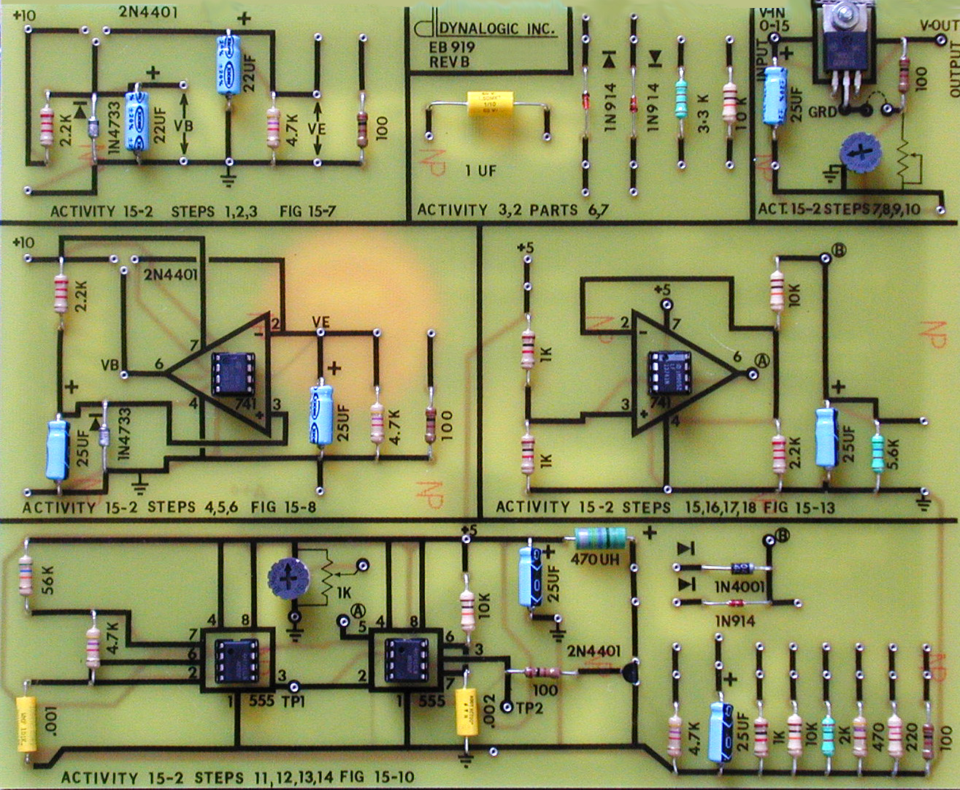
Lab Notebook for EECT 121
By: alex drummond
Lab Partner Were Seth Wills, Donald Stanley and Jarred Clark Beside the +/- 9 Volt Power Supply

Slide 2
Lab 1: The Switching Diode Date: 09/05/18
Lab Partner was Seth wills Donald Stanley And Jarred Clark
The Purpose Of this Lab was to:
Learn how a switching diode functions and build and test the diode while using multisim and using the equipment in the lab.
Equipment Needed:
Gwinsek GDM-8245 Multimeter
820 Ohm Resistor
1N4128 Se Switching Diode
1N4001 Switching Diode

Slide 3
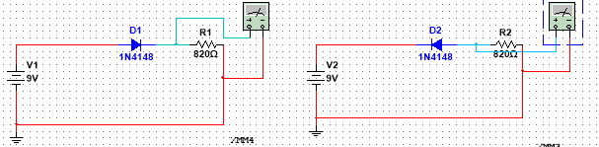
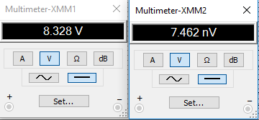
Lab 1: Part 2
Forward bias
Reverse bias
This multisim is a simulation of the 1N4148 diode in the forward and reverse bias. The diodes we used have a voltage drop of .7 volts. In the forward bias phase you get an output of a high (shown as 8.328 Volts)but in the reverse bias you get a low(shown as 7.462 NanoVolts) output.

Slide 4
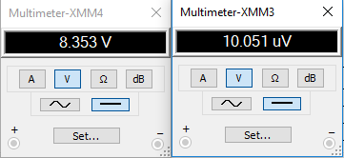
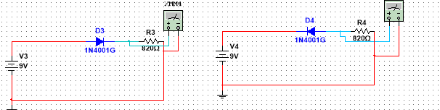
Lab 1:Part 3
Forward bias
Reverse bias
This multisim is a simulation of the 1N4001 diode in the forward and reverse bias. The diodes we used have a voltage drop of .7 volts. In the forward bias phase you get an output of a high (shown as 8.353 Volts)but in the reverse bias you get a low(shown as 10.051 MicroVolts) output.

Slide 5
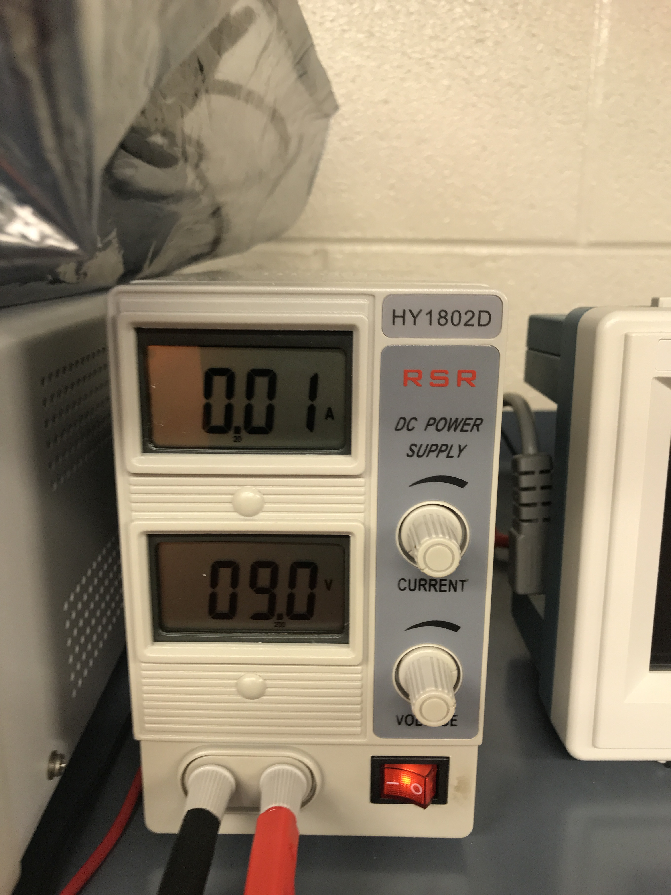
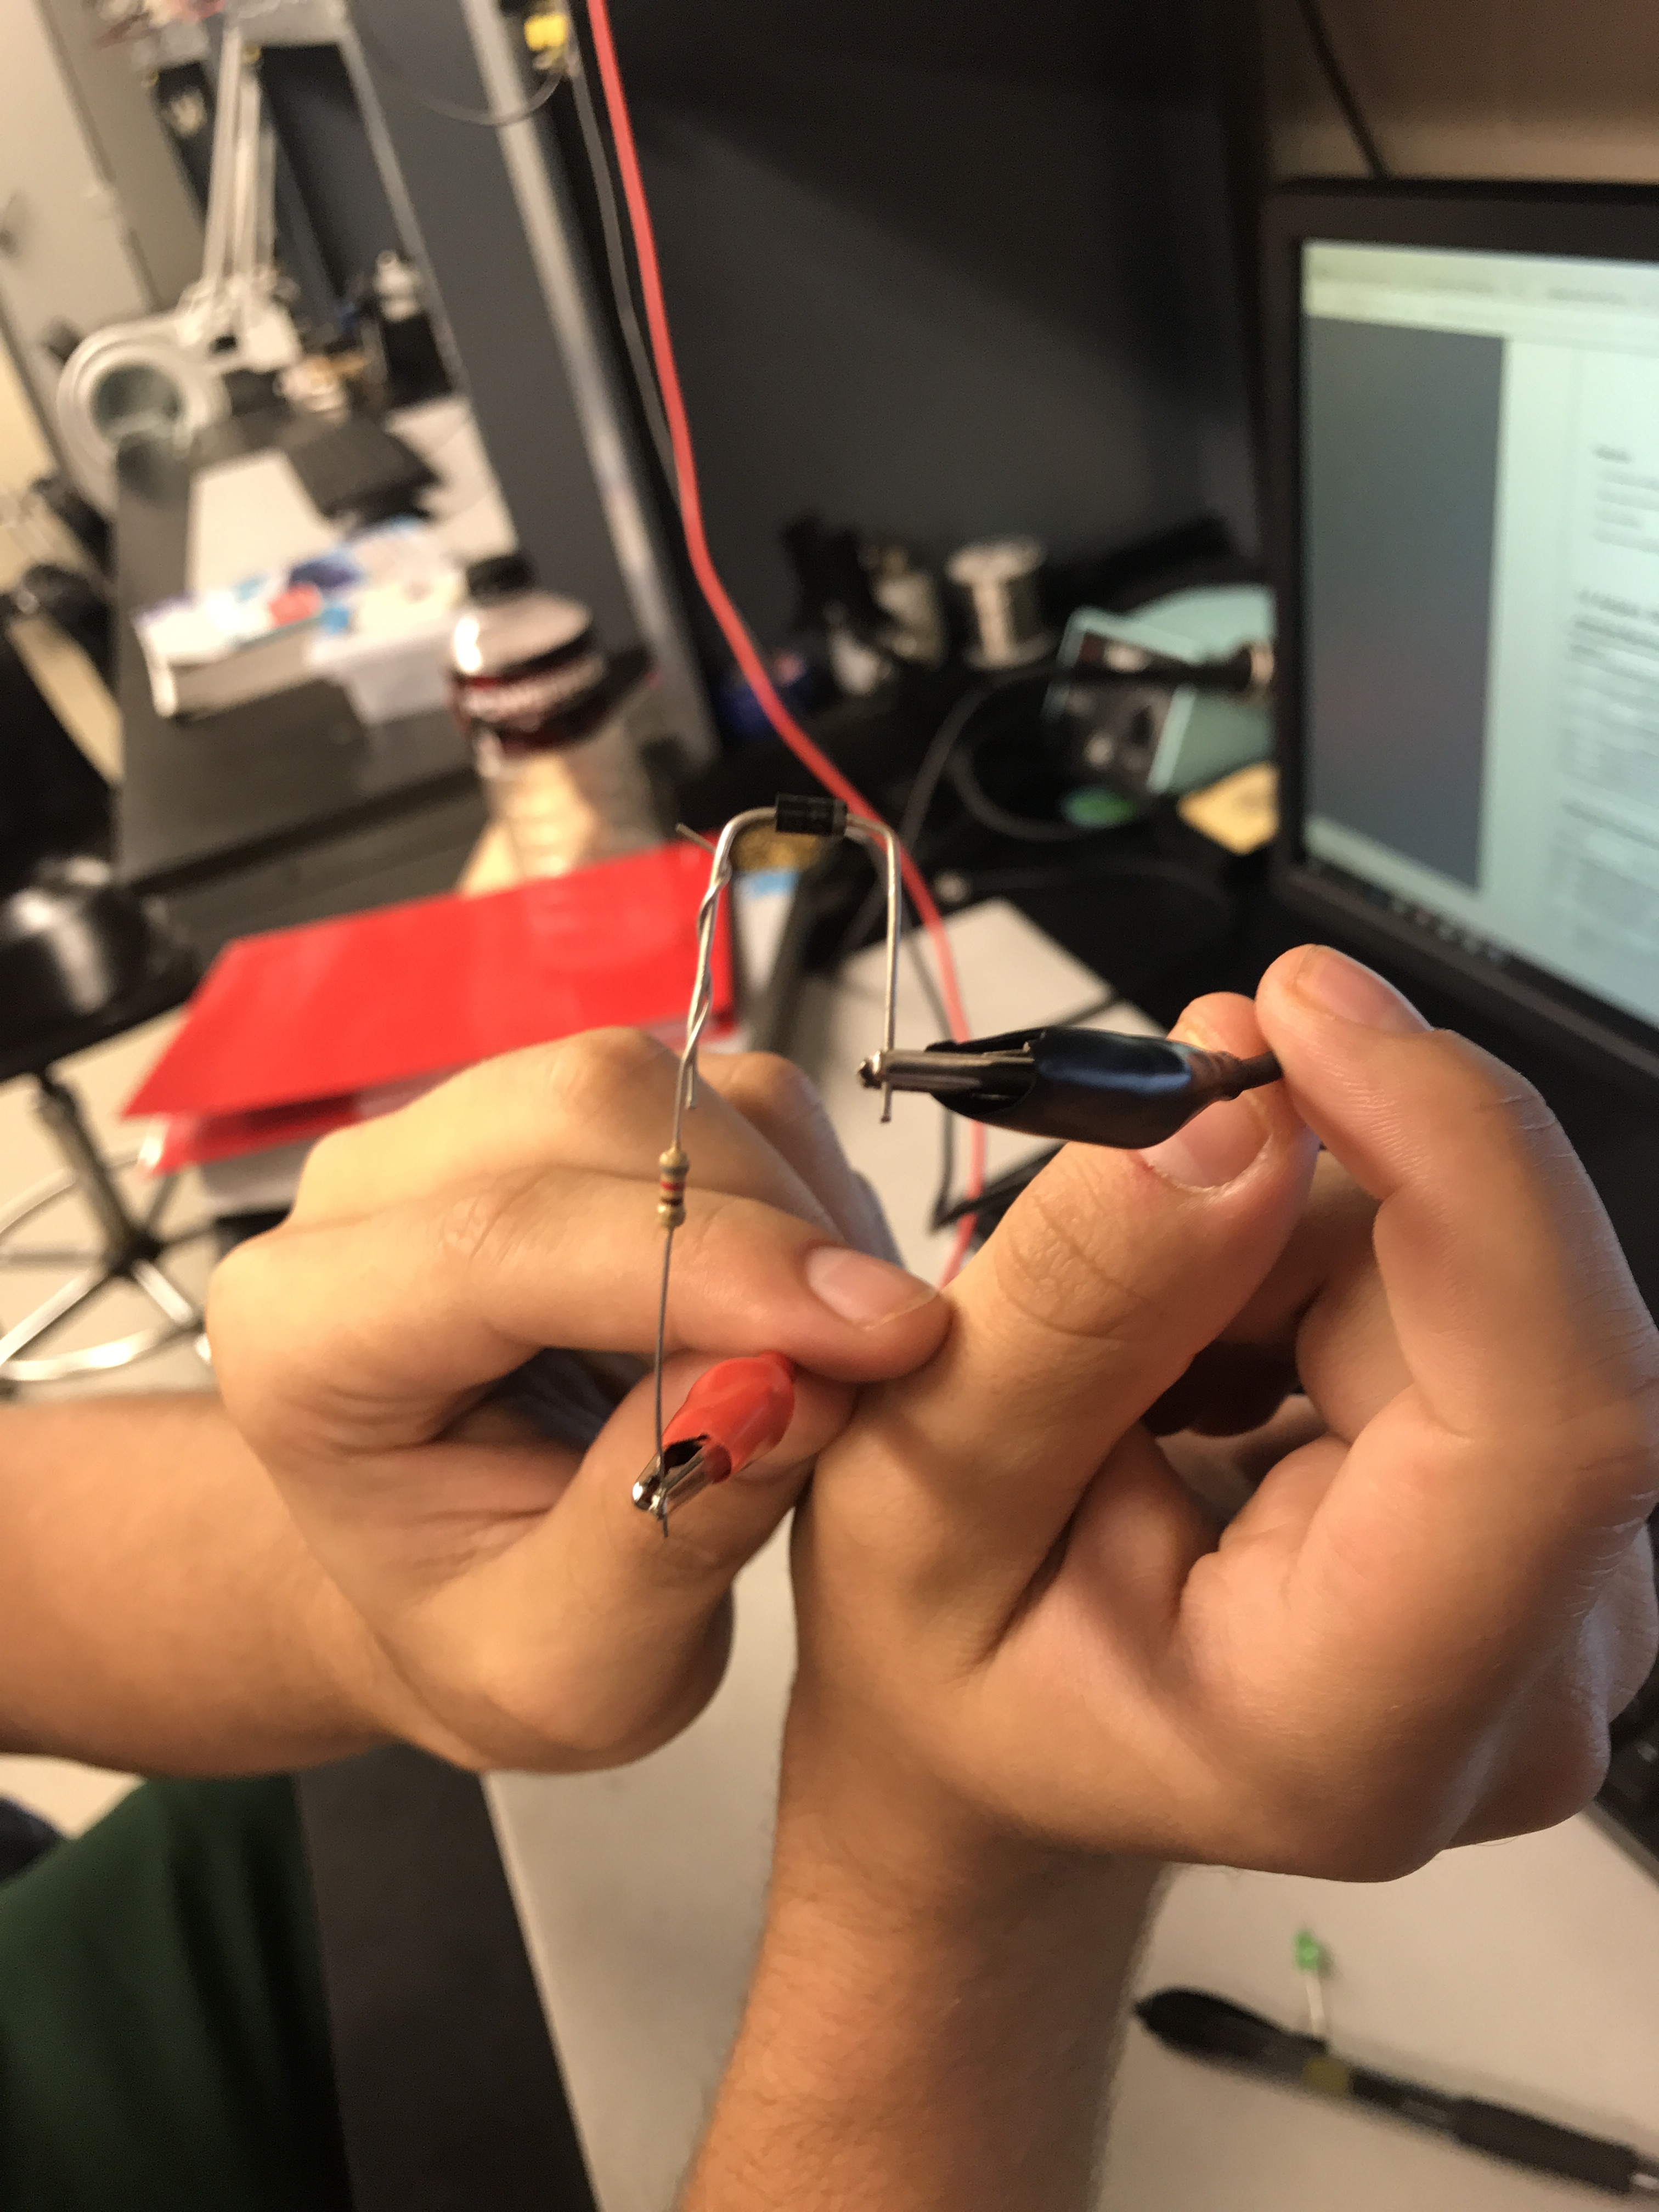
Lab 1: Part 4
Forward bias
Part: 1N4148
Applied voltage

Slide 6
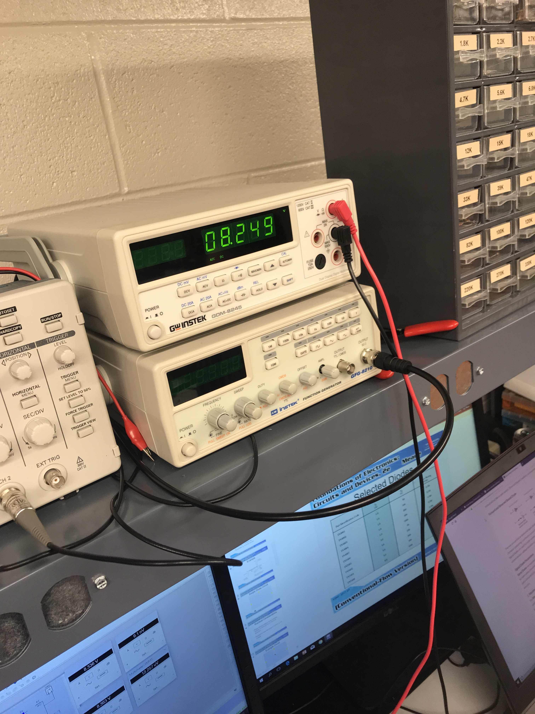
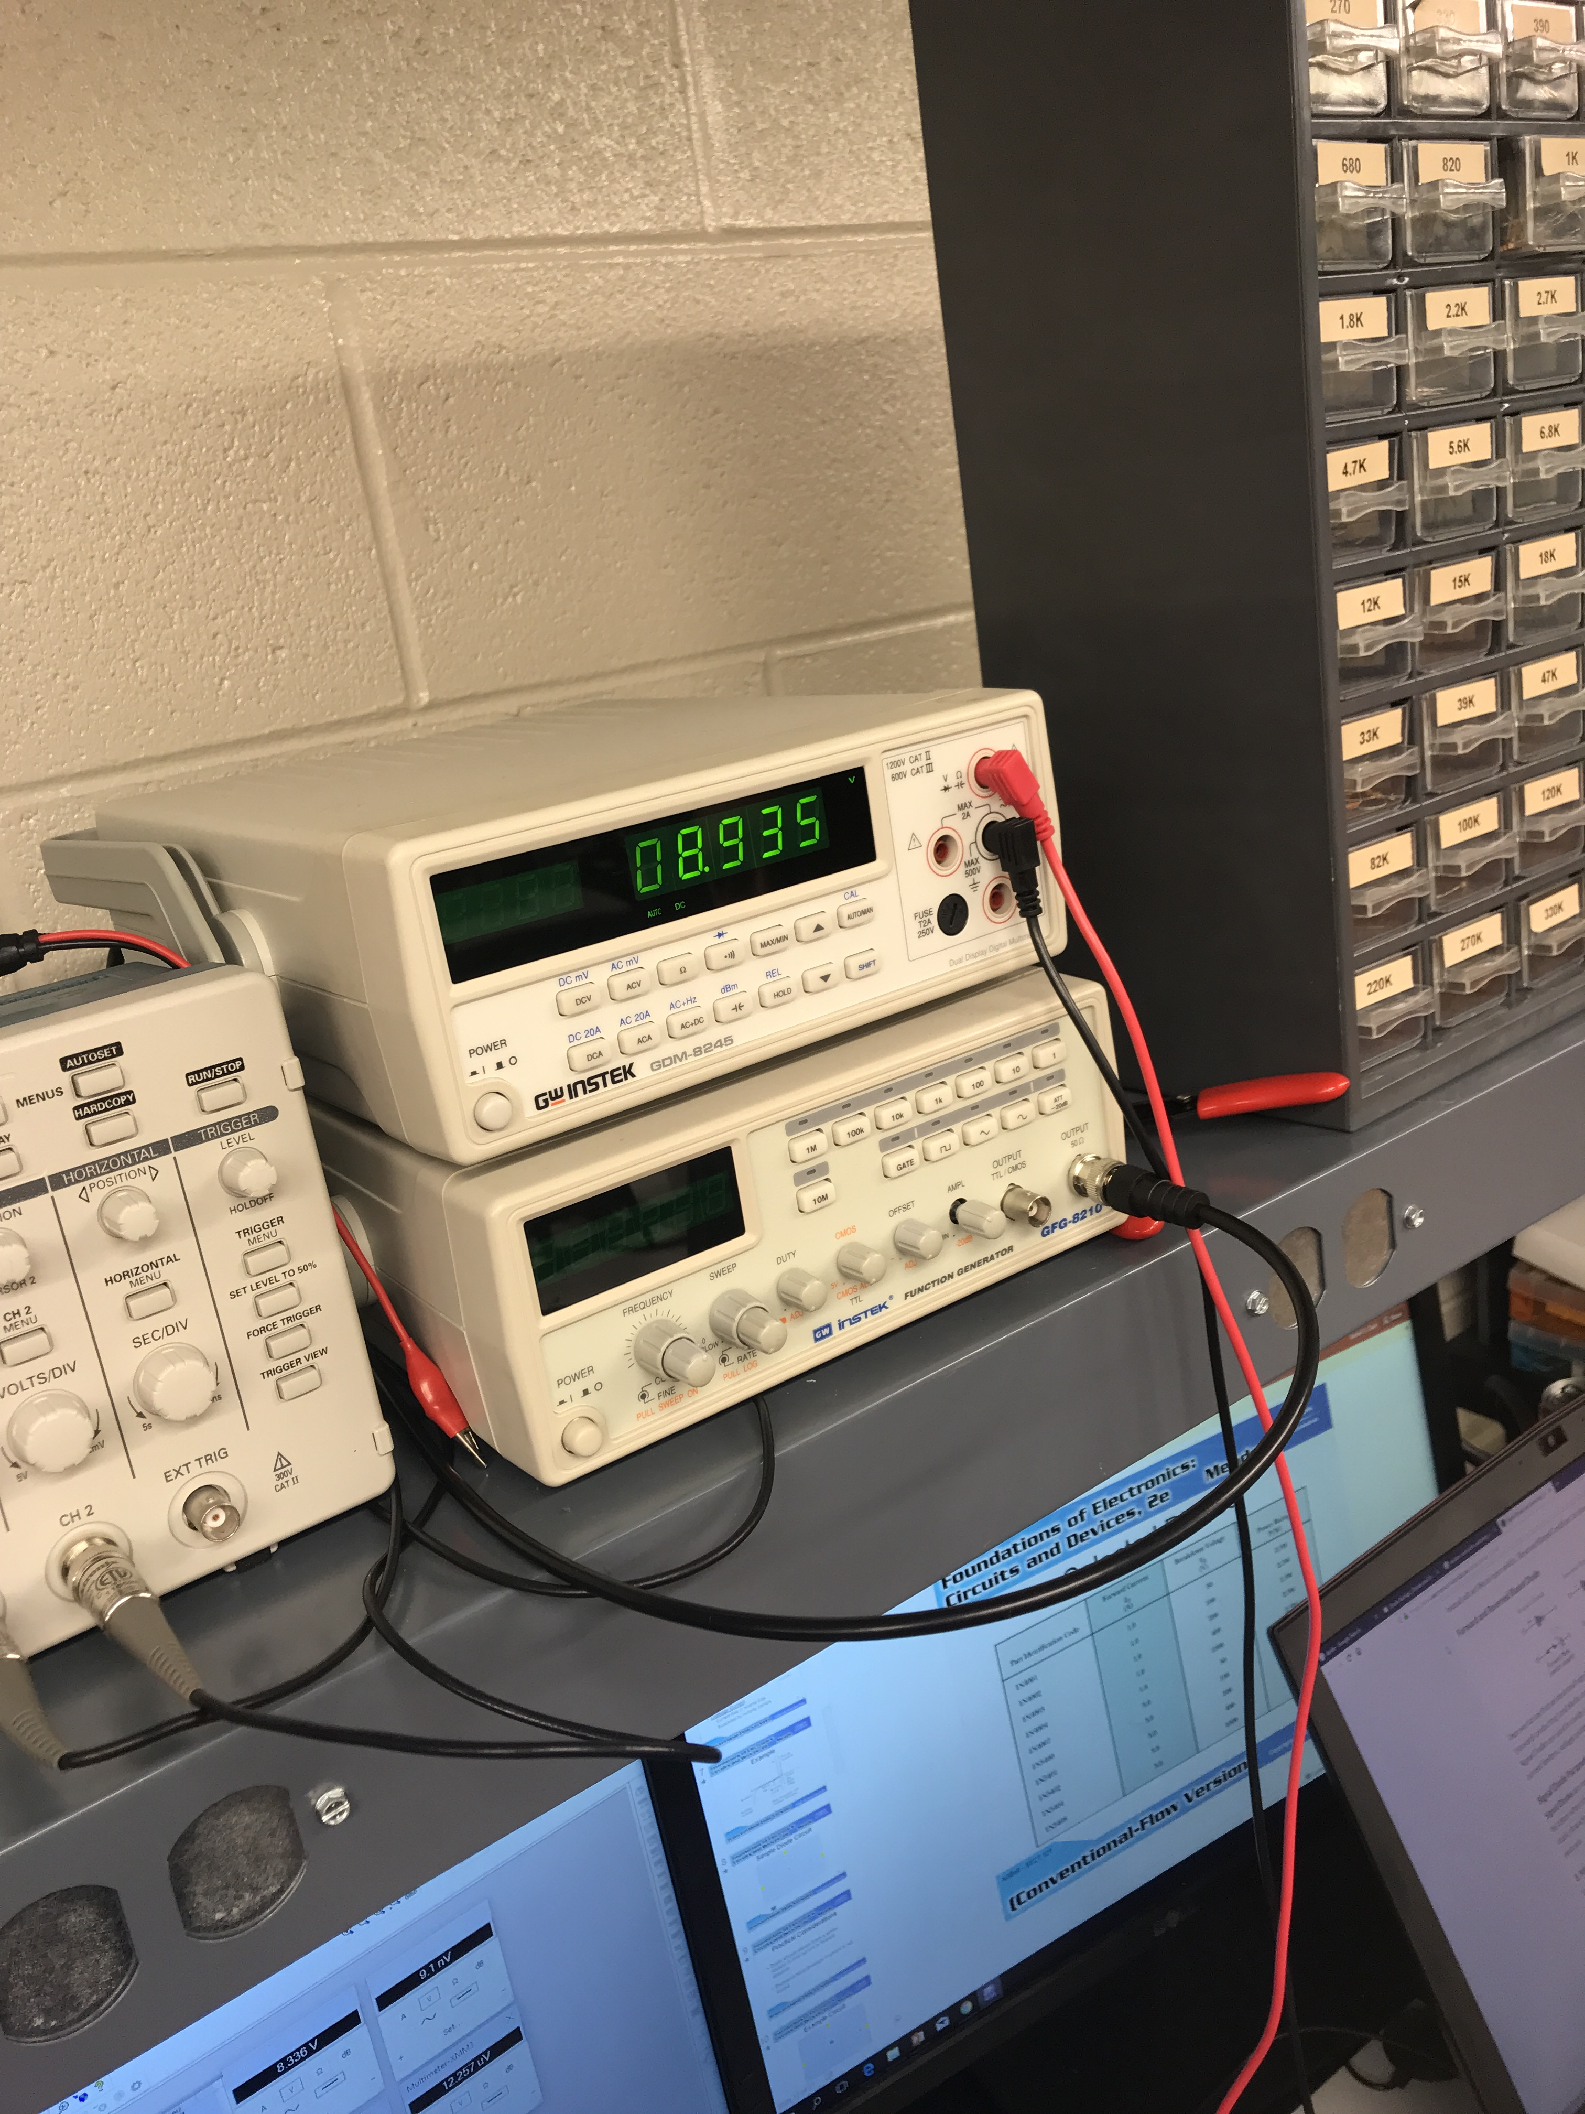
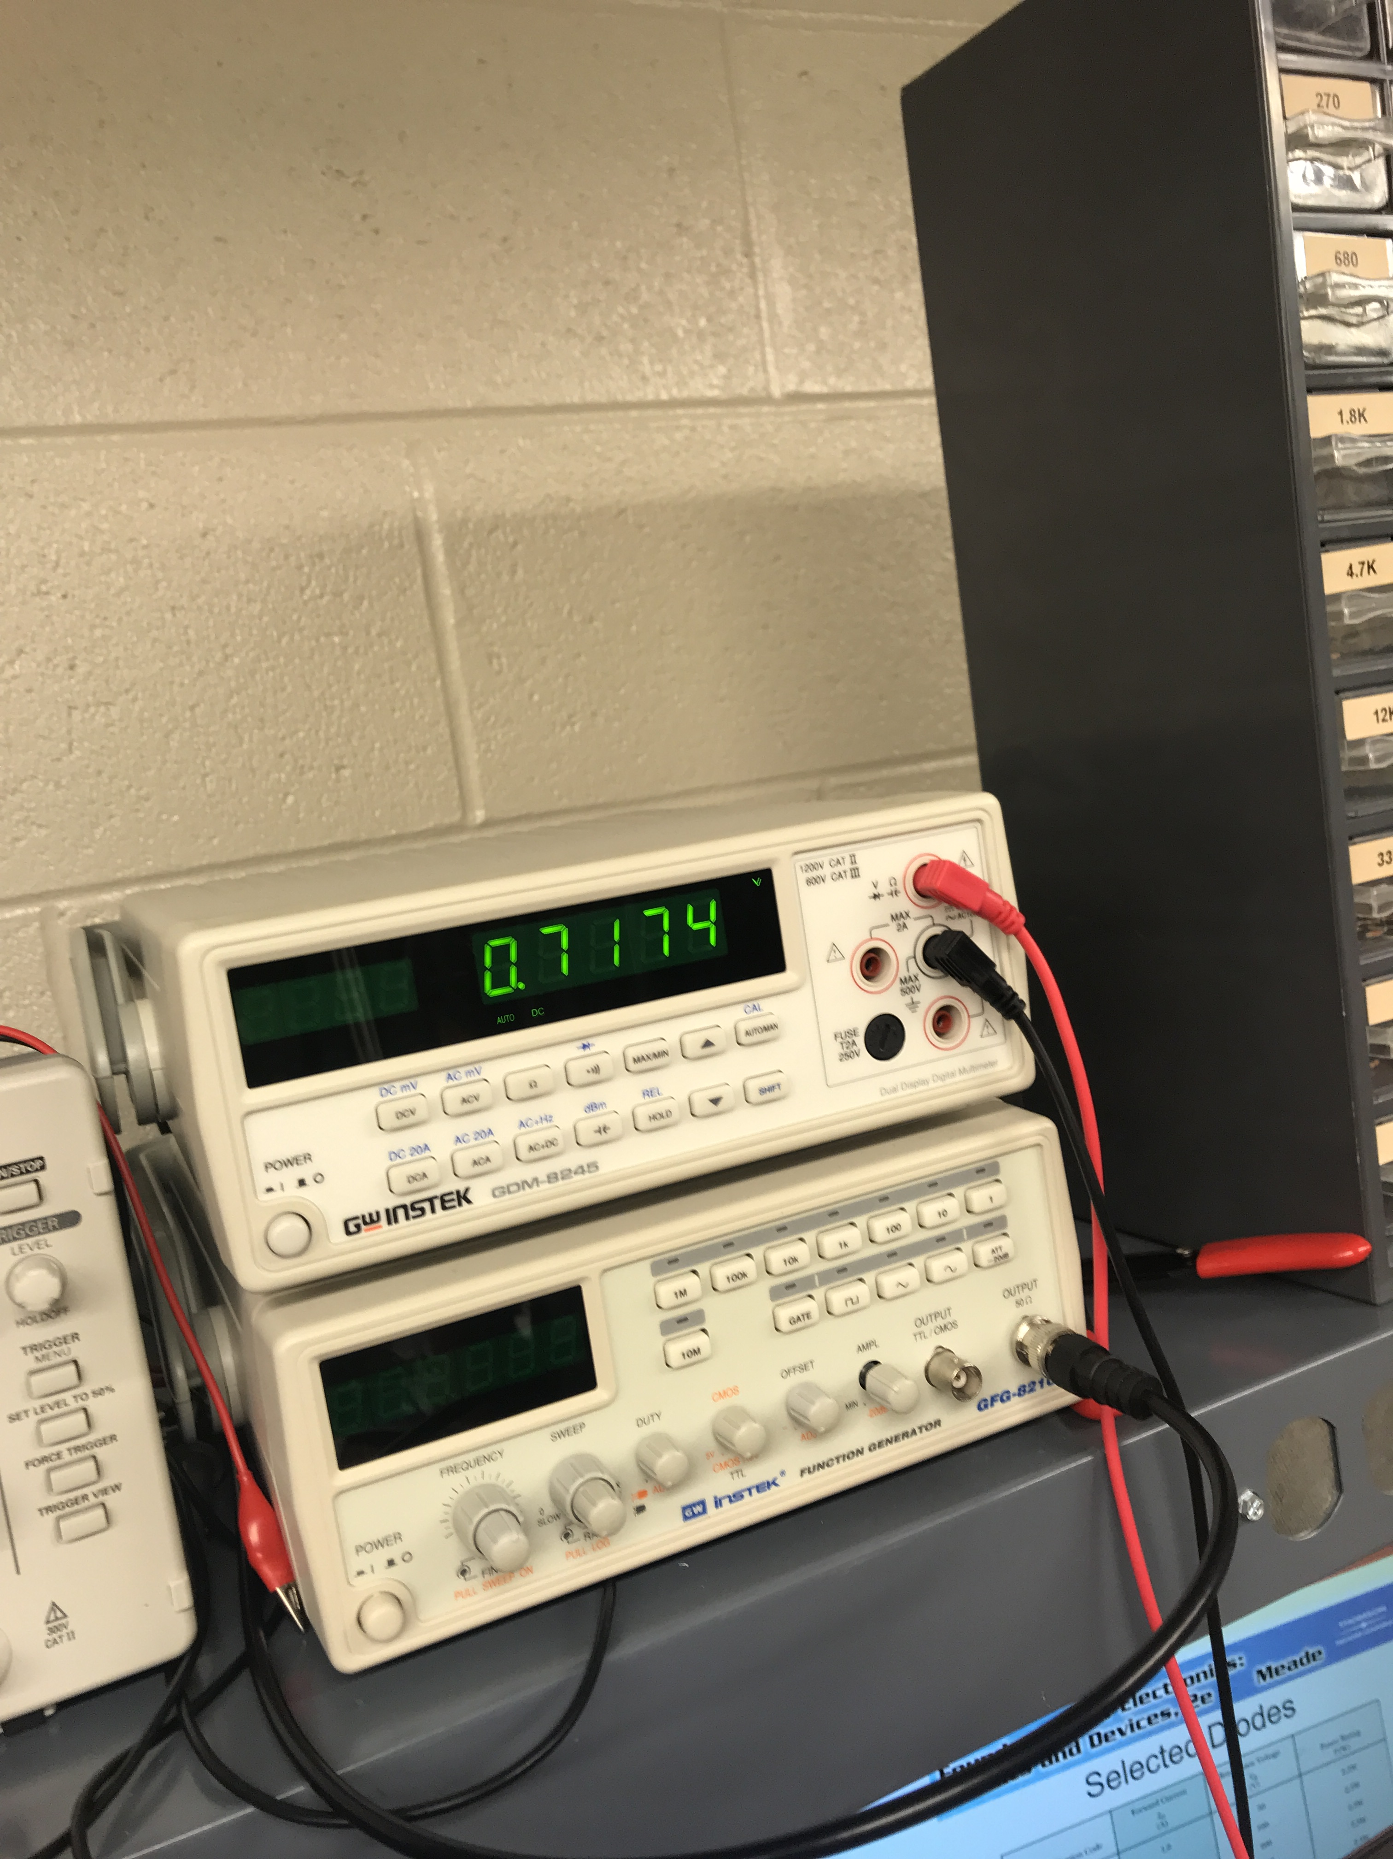
Lab 1
Output voltage in forward bias
Output voltage in forward bias #2
Output voltage in reverse bias

Slide 7
Lab 1: Part 7
Data sheet for the diode, displaying which side the cathode (black band)
PUT PICTURES HERE

Slide 8
Lab 1: Observation
A diode has two biases one is forward and one is reverse. When one is in forward bias it is considered on. When the diode is in reverse bias it is consider to be off.

Slide 9
Lab 2:LEDs
Lab Partner was Seth wills Donald Stanley and Jarred Clark
Date: 09/05/18
The Purpose of this is to:
Learn how a LED functions and build and test the LEDS while using multisim and using the equipment in the lab.
Parts and Equipment Needed:
560 ohm Resistor
330 ohm Resistor
680 ohm Resistor
LED – 08L53GD - Green
LED – 08L53YD - Yellow
LED – 08L53ED – Amber (RED)
HY1802D DC Power Supply
Gwinstek GDM-8245 Multimeter
Breadboard

Slide 10
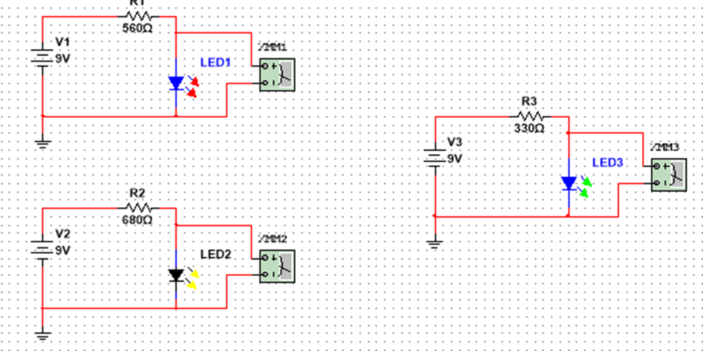
Lab 2: Part 2
This is the simulation of the three LEDs that we tested. The color were red, green, and yellow. We used 3 different resistors for each LED. For the red led we used 560 ohms, for the yellow led we used the 680 ohm resistors and for the green led we used the 330 ohm resistor.

Slide 11
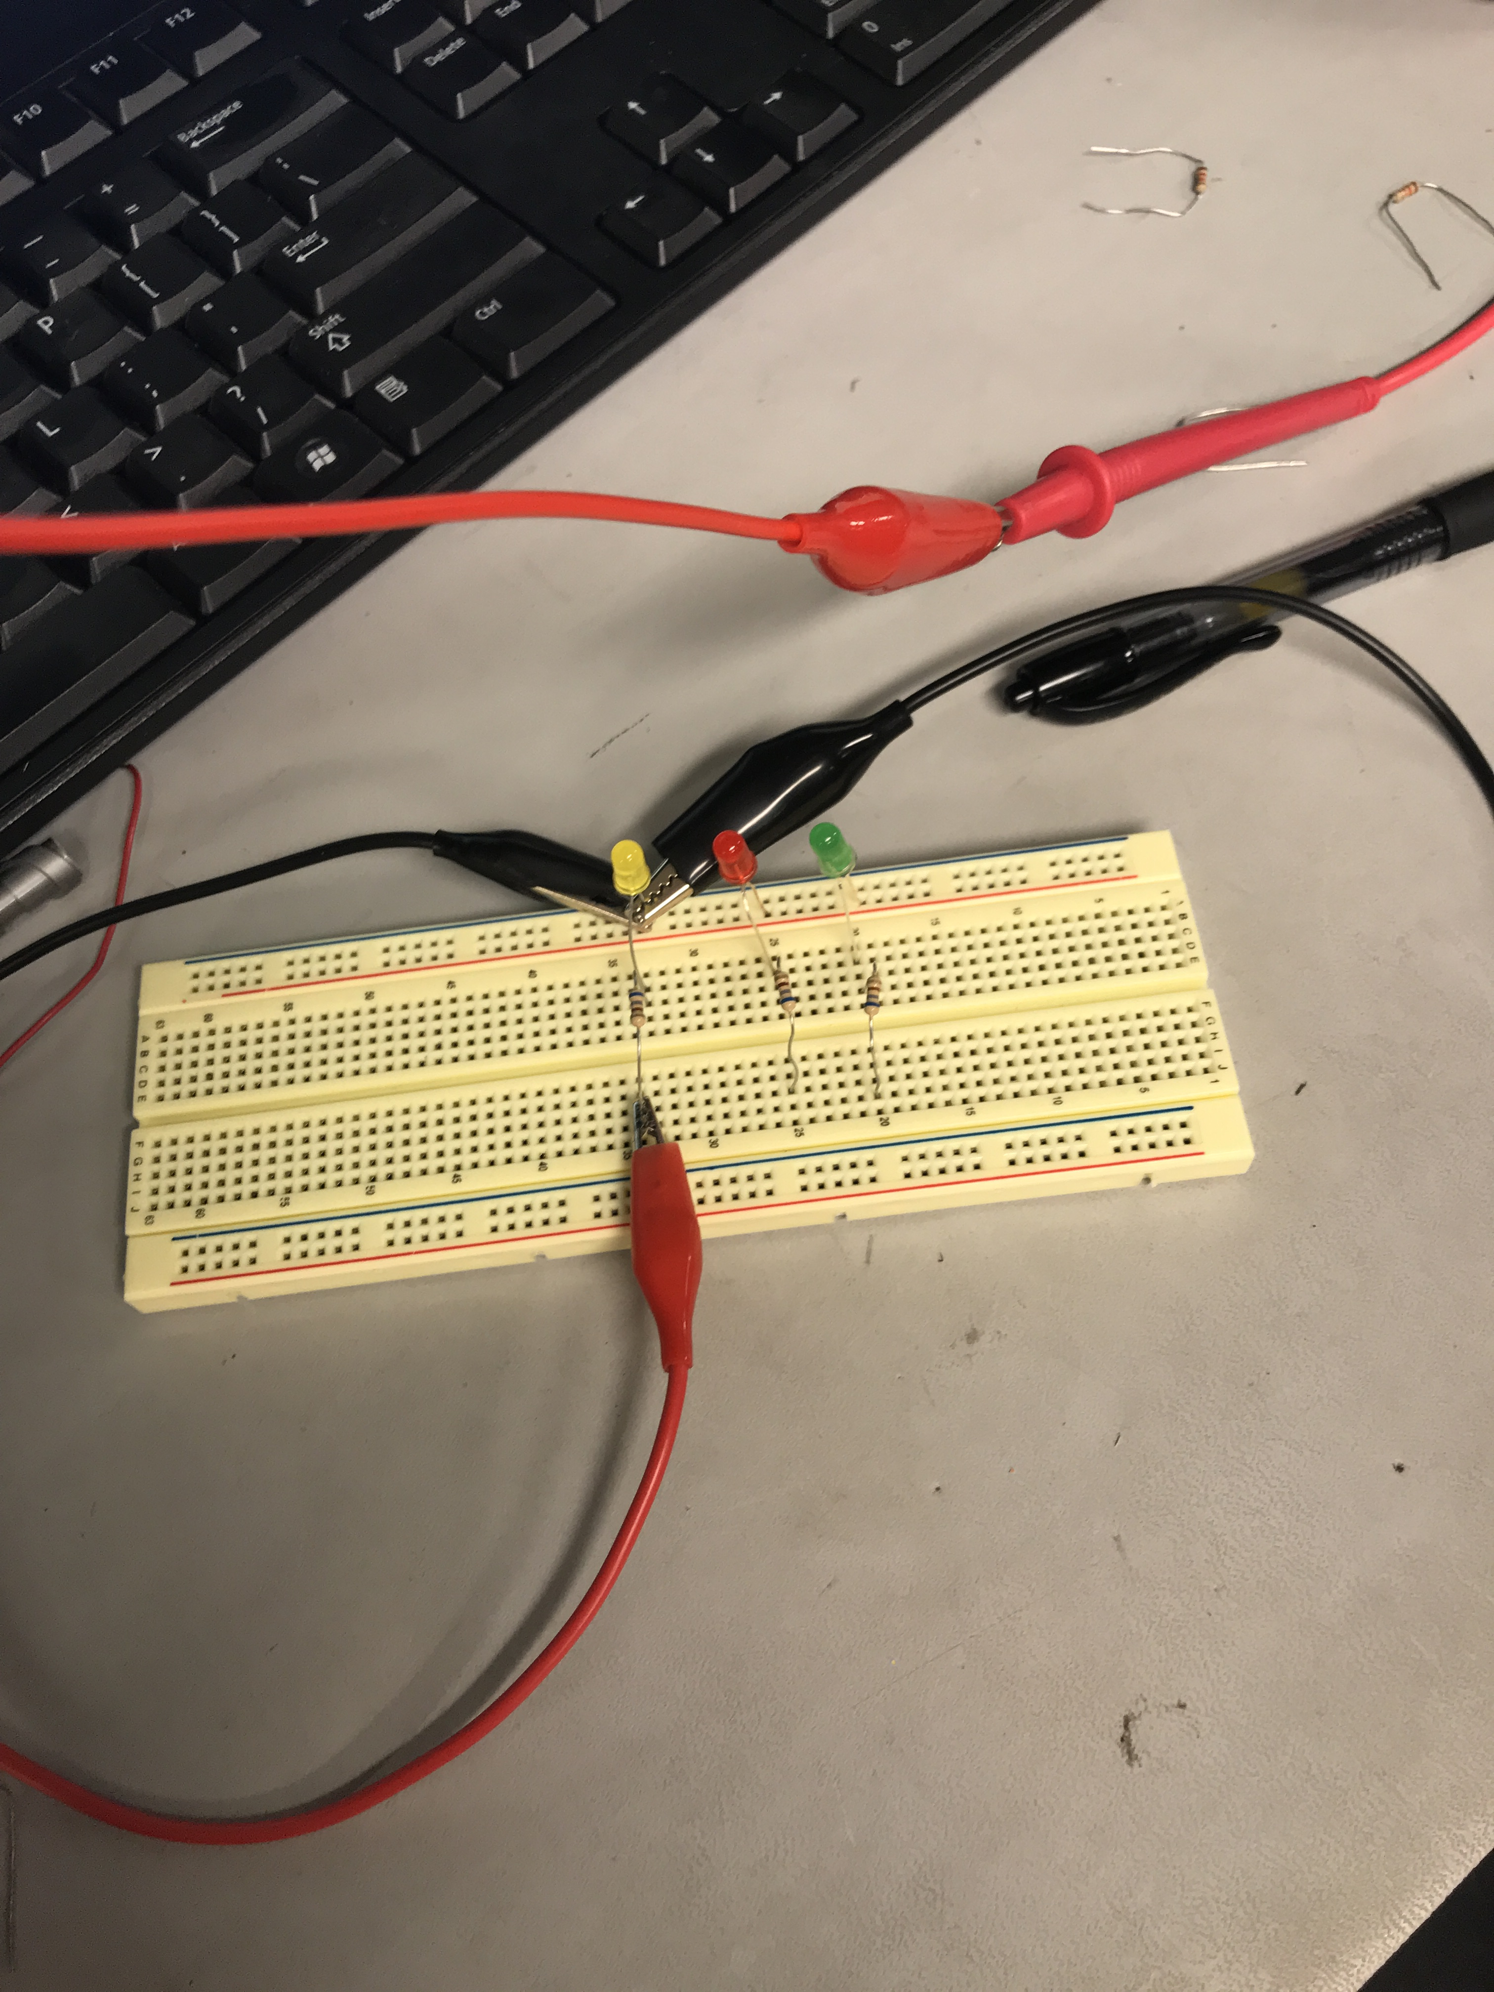
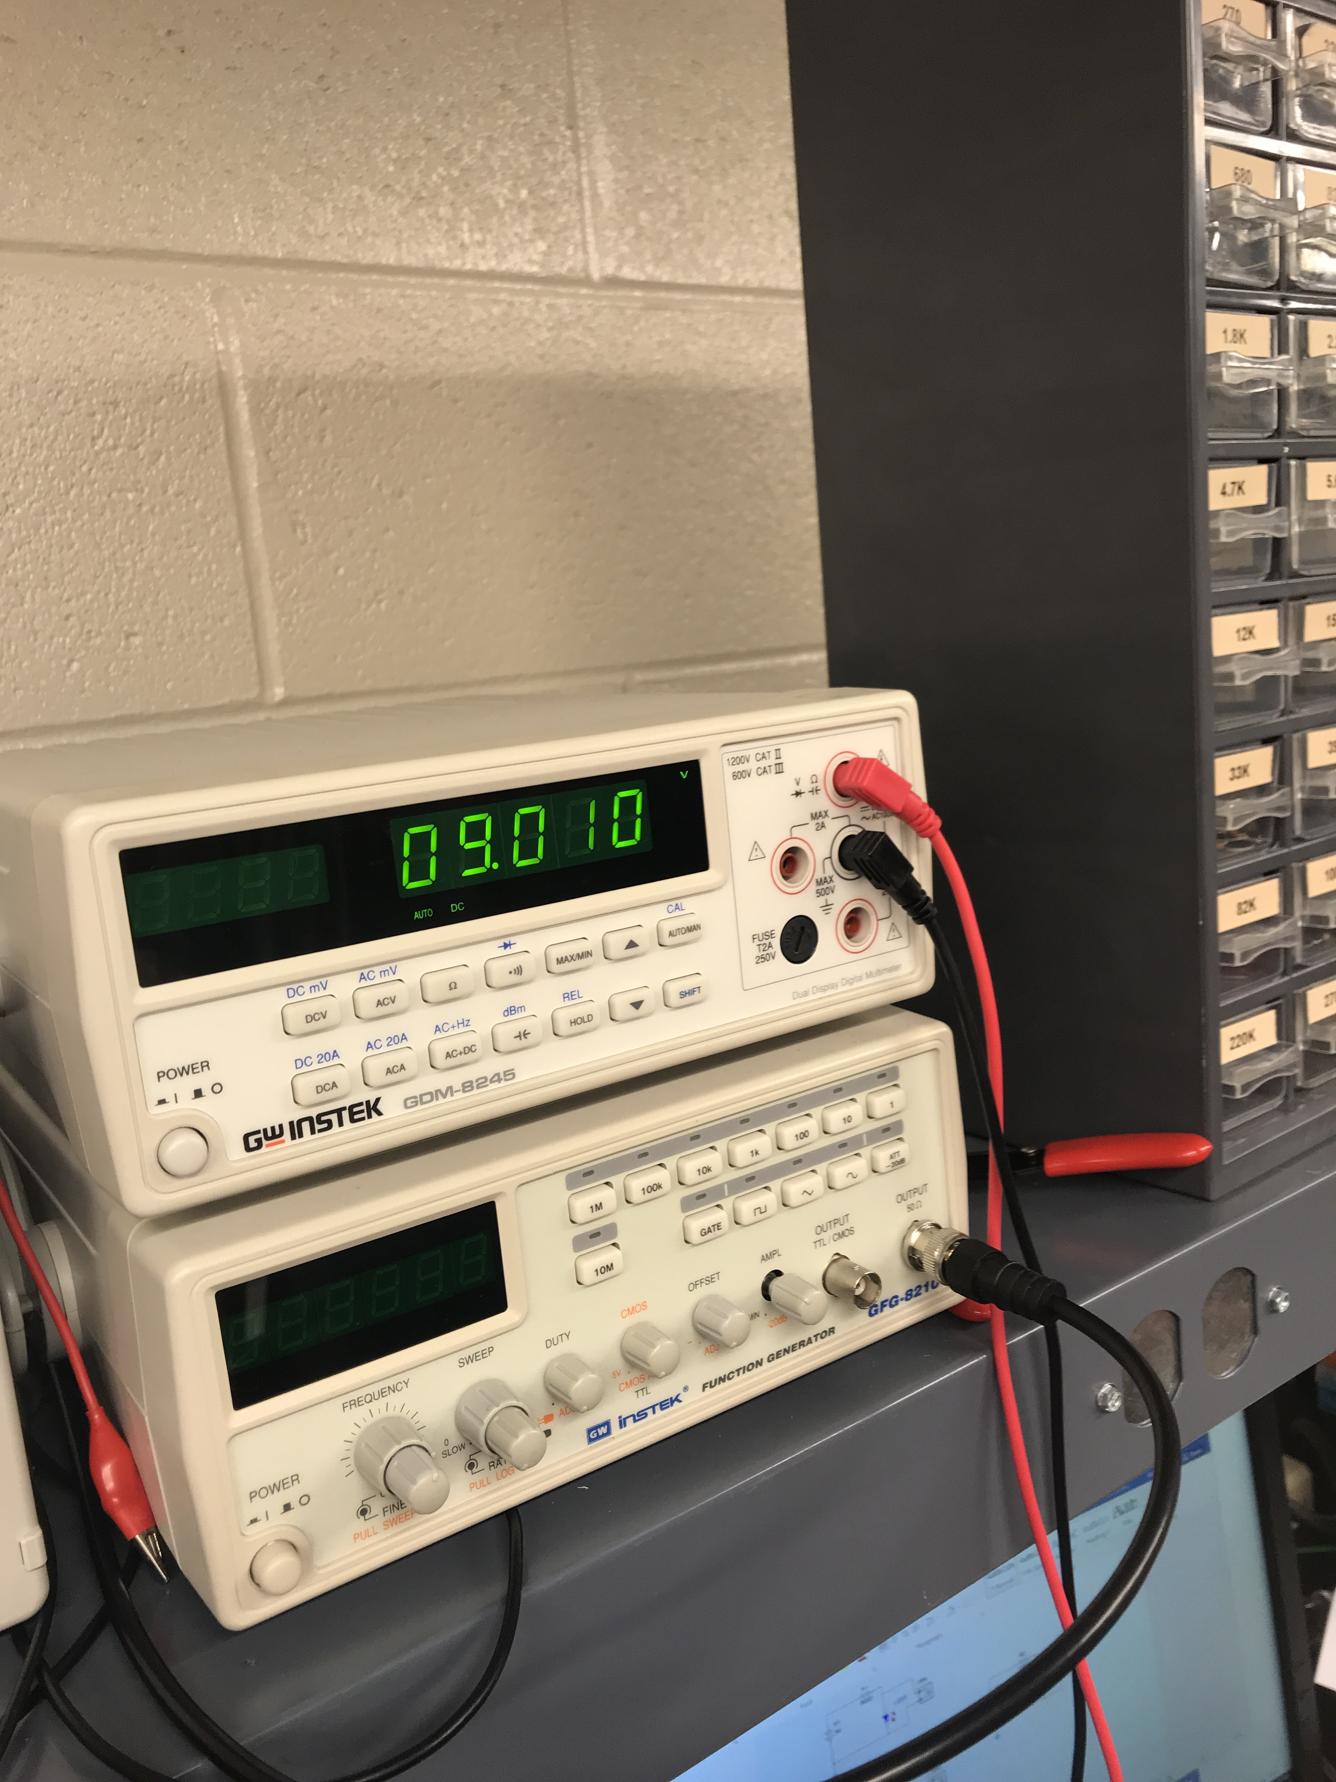
Lab 2: Part 3
circuit set up
Voltage before going to the LED

Slide 12
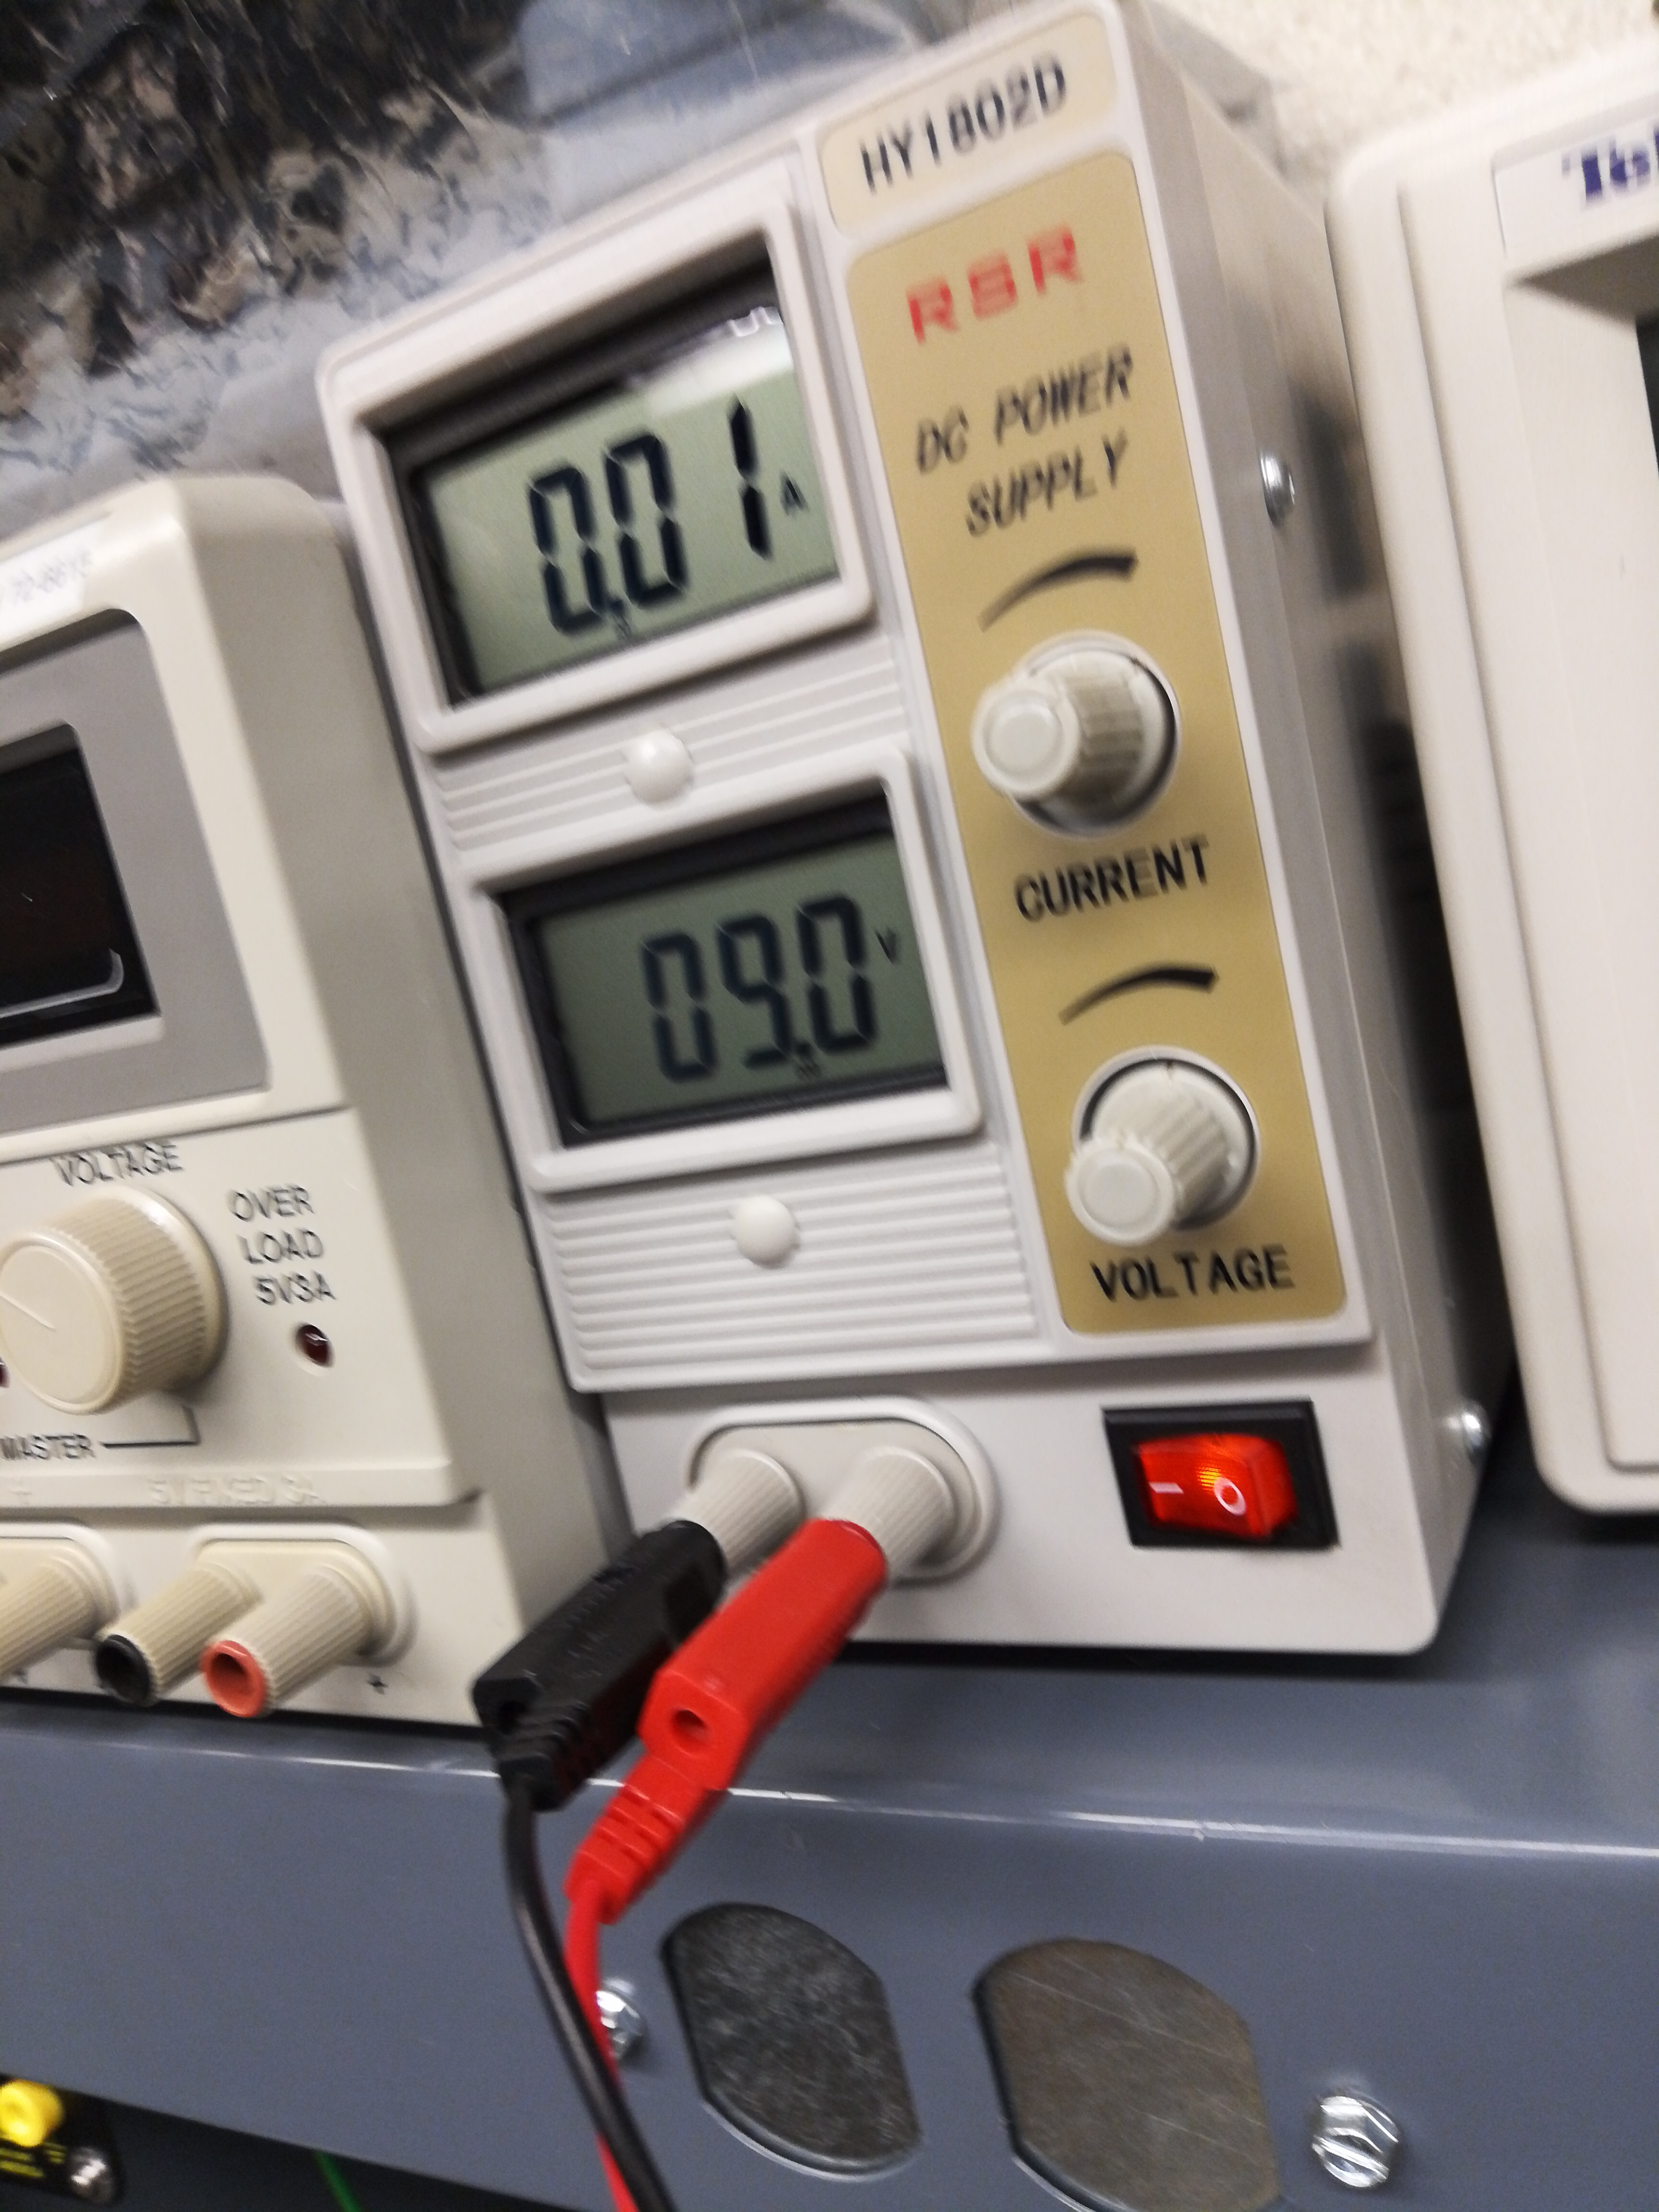
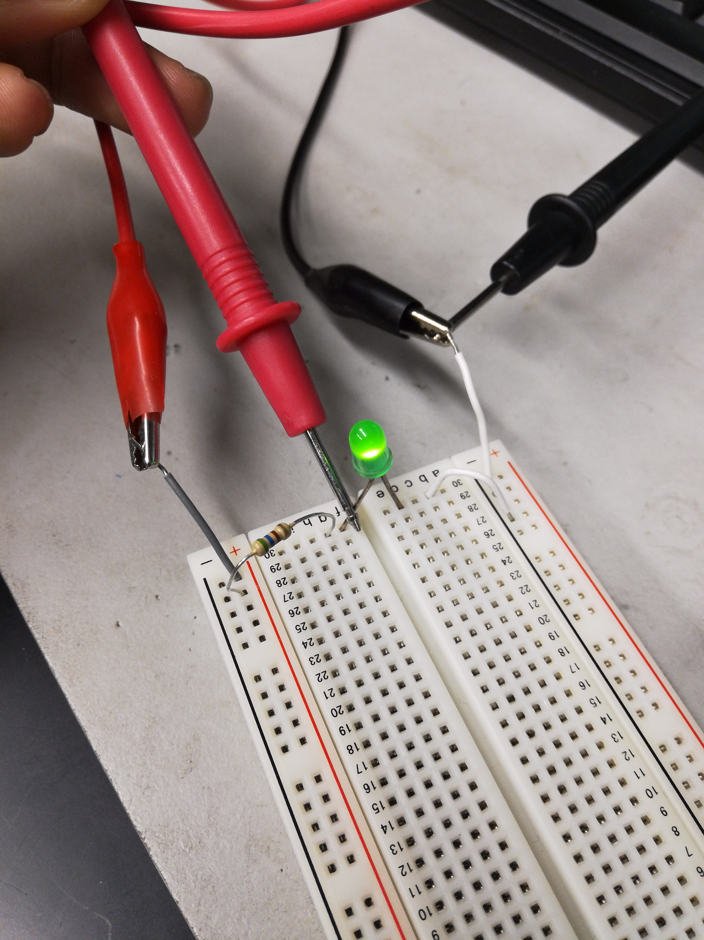
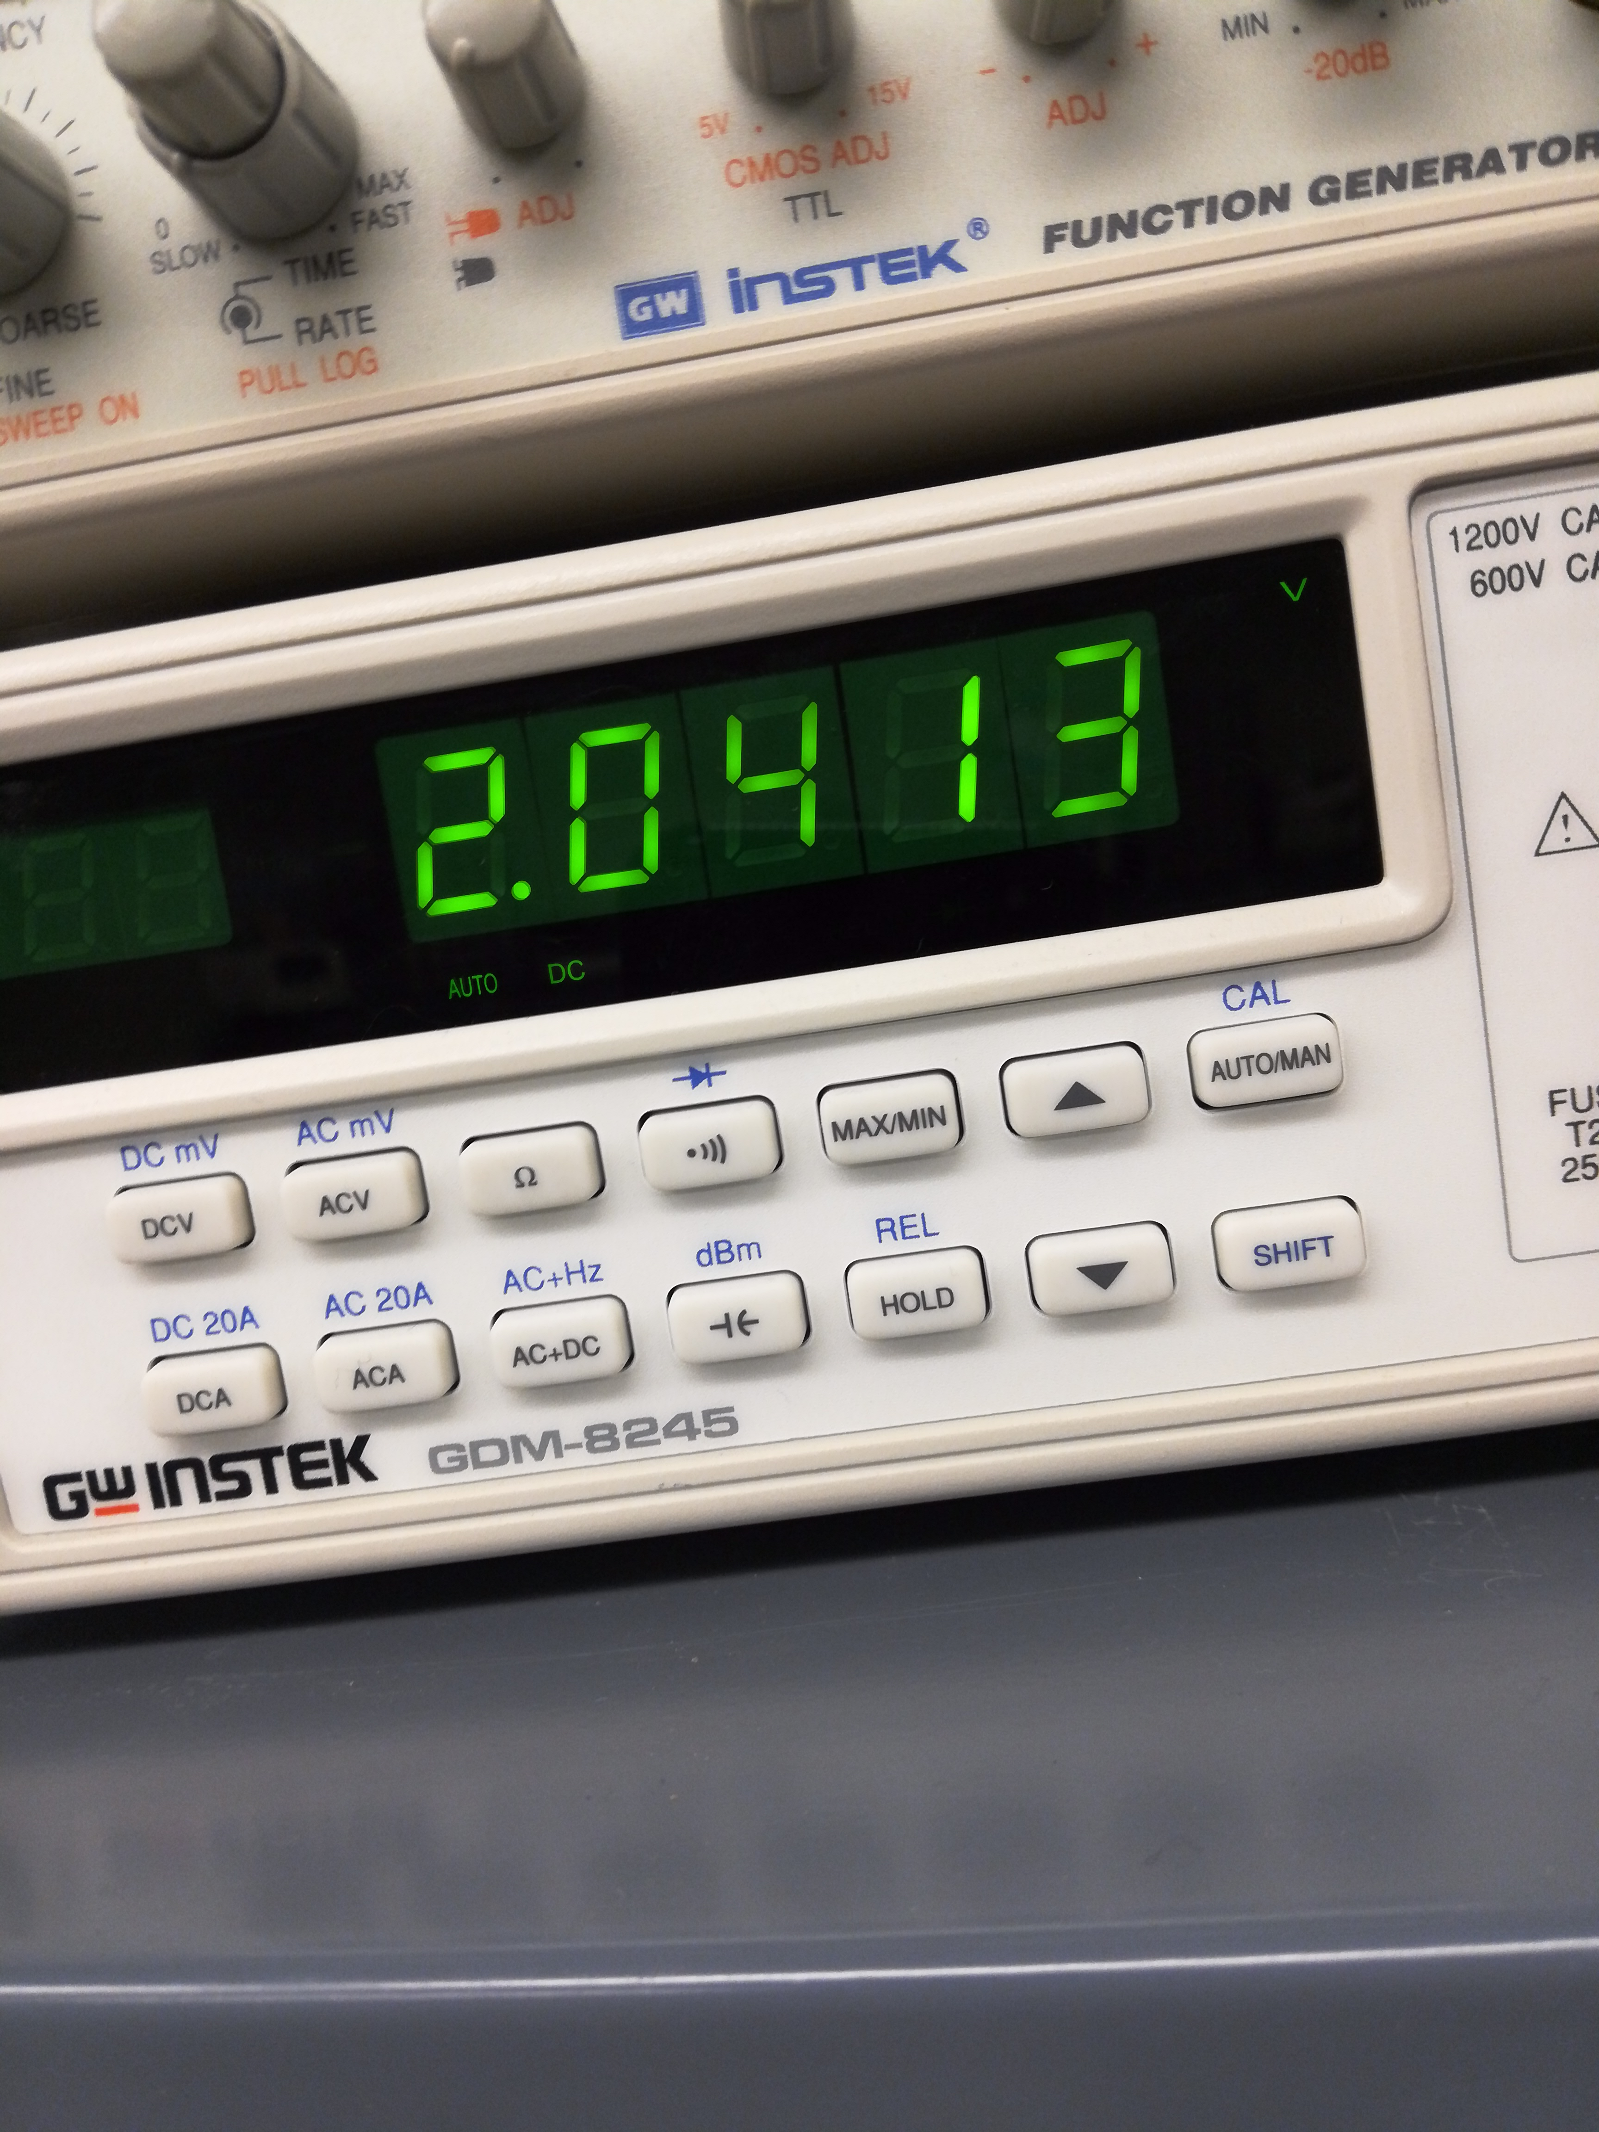
Lab 2: Part 4
Voltage before after resistor
Input voltage
& measurement before LED

Slide 13
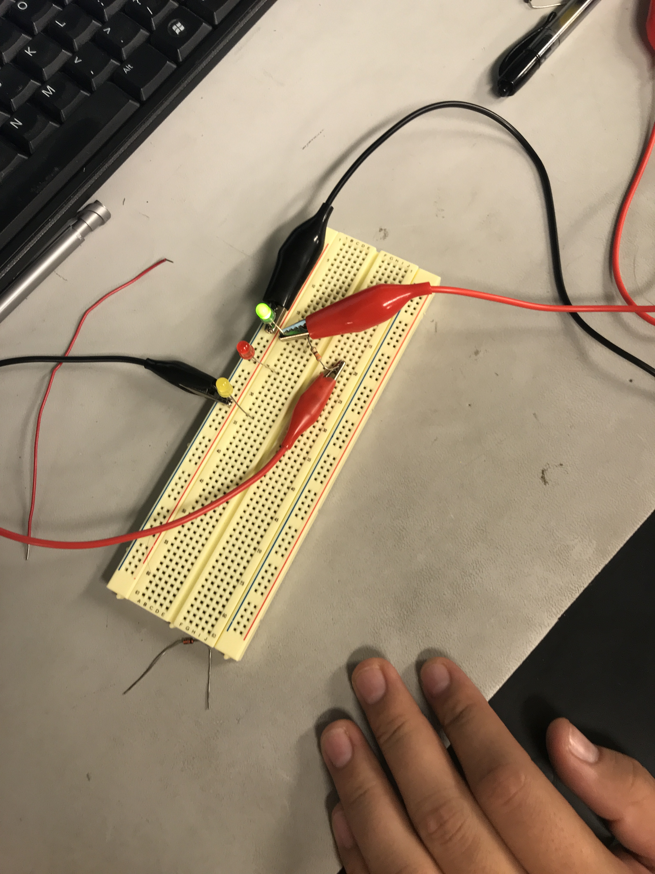
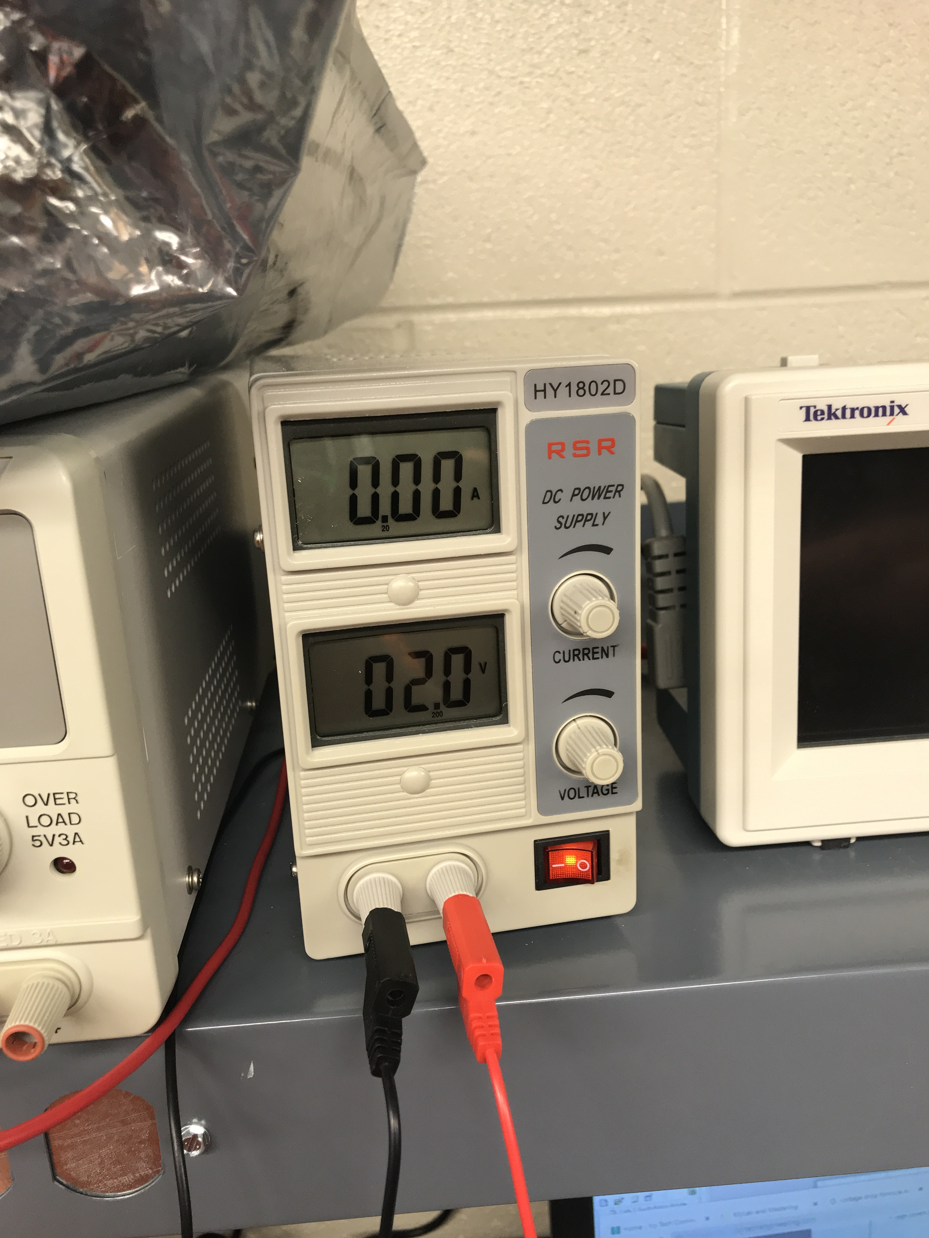
Lab 2 Part 5
Green LED
Voltage when the LED turns off

Slide 14
Lab 2: Observations
For each color of led we had to use a different resistors because each led needs more watts to have the light visible

Slide 15
LAB 3: Zener Diode
Lab Partner was Seth wills Donald Stanley and Jarred Clark
The purpose of this lab is to:
Learn how a Zener Diode functions and build and test the Zener Diodes while using multisim and using the equipment in the lab.
Parts needed:
1k Ohm Resistor
ZENER 1N4728A
ZENER, 1N4732A
ZENER, 1N4733A
ZENER 1N4735A
ZENER, 1N4736A
Equipment Needed:
1 – GDM-8245 Multi-meter
1 – HY1802D DC Power source
1 – Breadboard

Slide 16
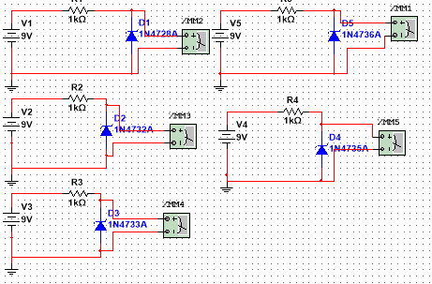
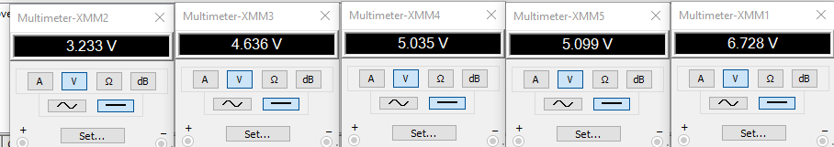
Lab 3: Part 2
This is the simulation and simulation results of 5 different zener diodes

Slide 17
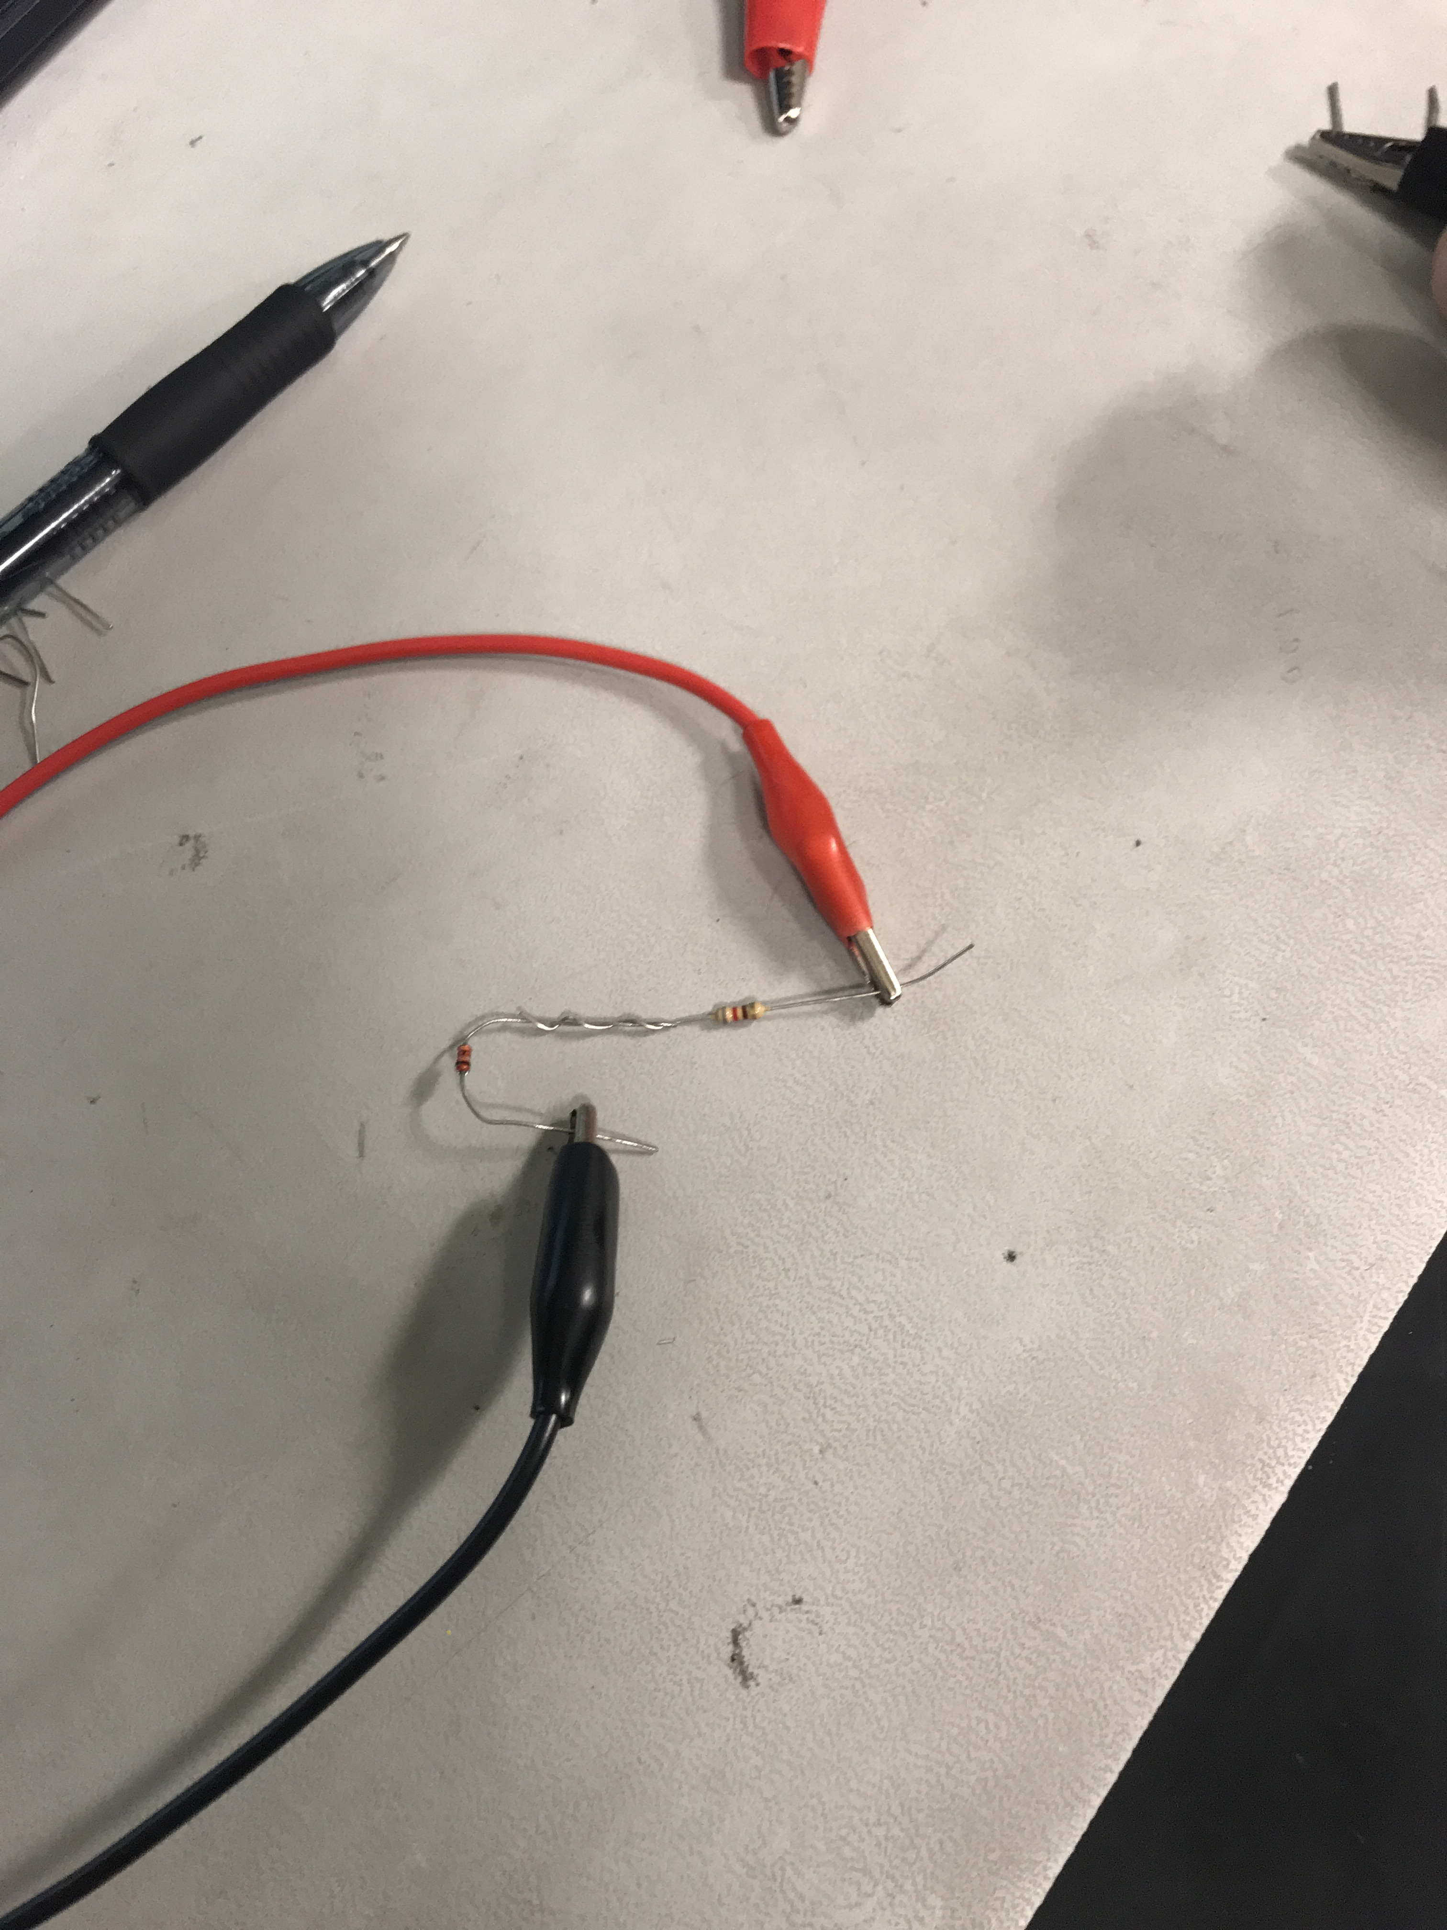
Lab 3: Part 3
ADD Pictures

Slide 18
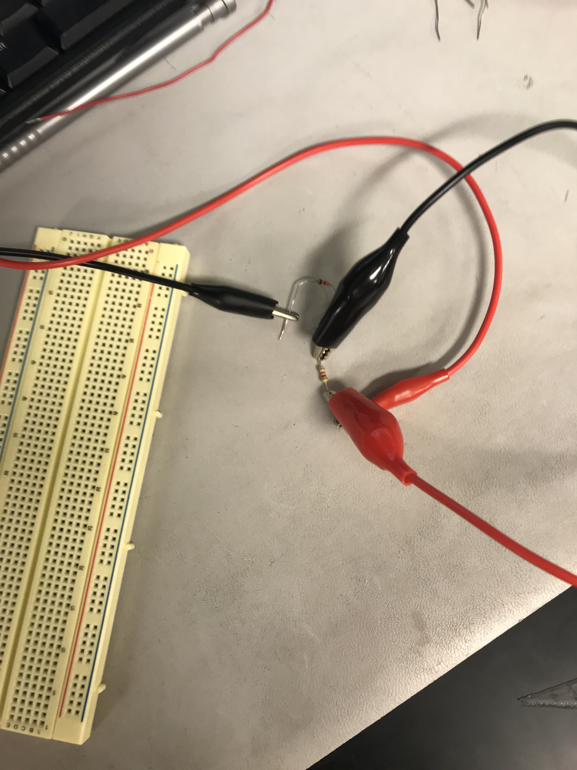
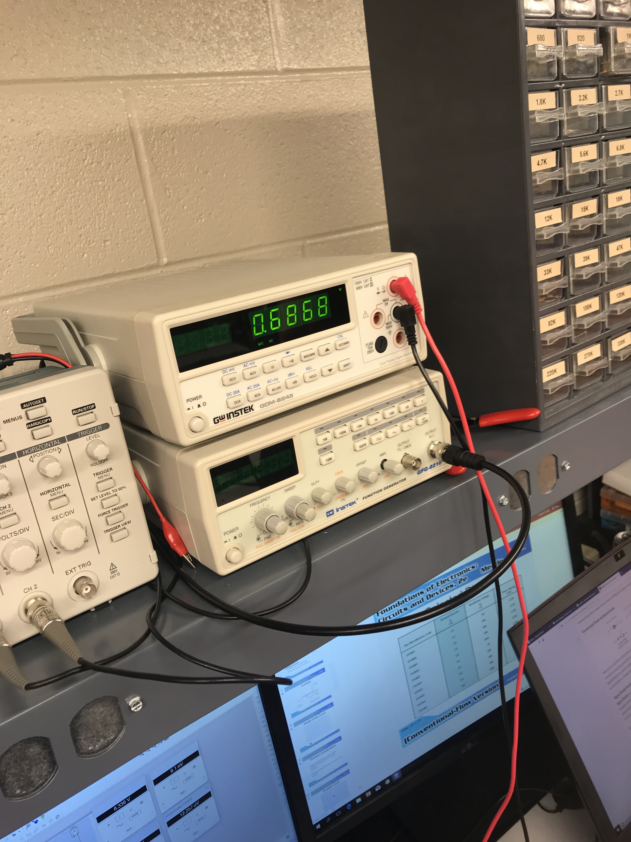
Lab 3: Part 4

Slide 19
Lab 3: Observations
I this lab we observed that zener diodes work differently then regular diodes in the previous labs. Zener diodes work in reverse bias instead of the forward bias. Zener diodes are used to regulate voltages in a small circuit.

Slide 20
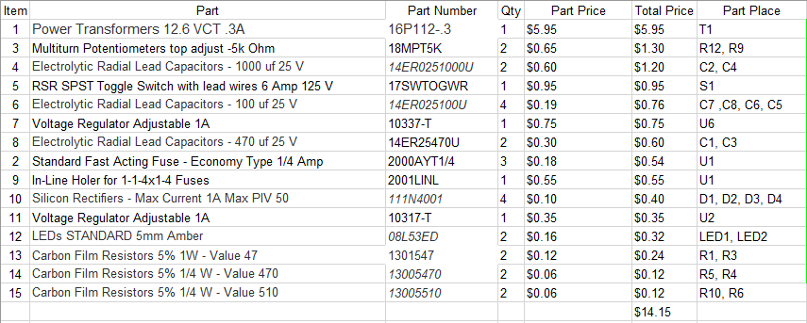
Lab 4: 9V +/- Power Supply
Lab Partner was Donald Stanley and kyaw ya
The Purpose of this Lab is to Build and design/test a +/- 9 Volts DC Power Supply
Equipment Needed:
HY1802D DC Power Supply
Gwinstek GDM-8245 Multimeter
Circuit Board
Soldering Gun and Solder
12.6 volt Transformer
Fuse Holder/fuse
Switch
4-1N4007
4-400uf Capacitors
2- Orange LED’s
2-20 ohm Resistors
LM 317 and LM 337
2-330 Ohm Resistors
2- Potentiometers
2-240 Ohm Resistors
2-100uf Capacitors
2-90 Ohm resistors for the load
2-10 Ohm Resistors for the load

Slide 21
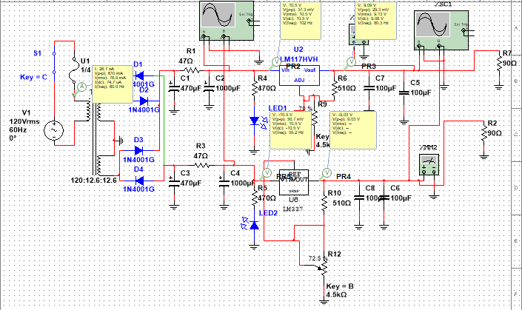
Lab 4: Part 2
This is the multisim built from scratch in order to create and build/Test the +/- 9 Volts DC Power Supply

Slide 22
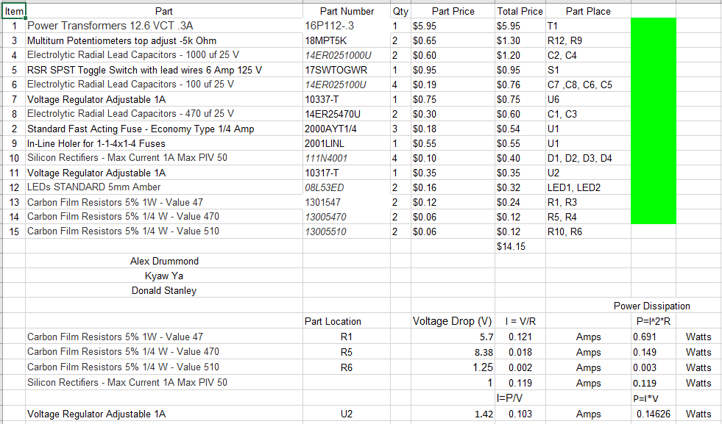
Lab 4: Part 3
This is our BOM (Bill of Materials) that we made in order to total up the cost and order all the parts for the Power Supply. Maximum cost was 25 dollars and we totaled up to $14.15

Slide 23
Lab 4: Part 4
Datasheet for LM337
Datasheet for LM317

Slide 24
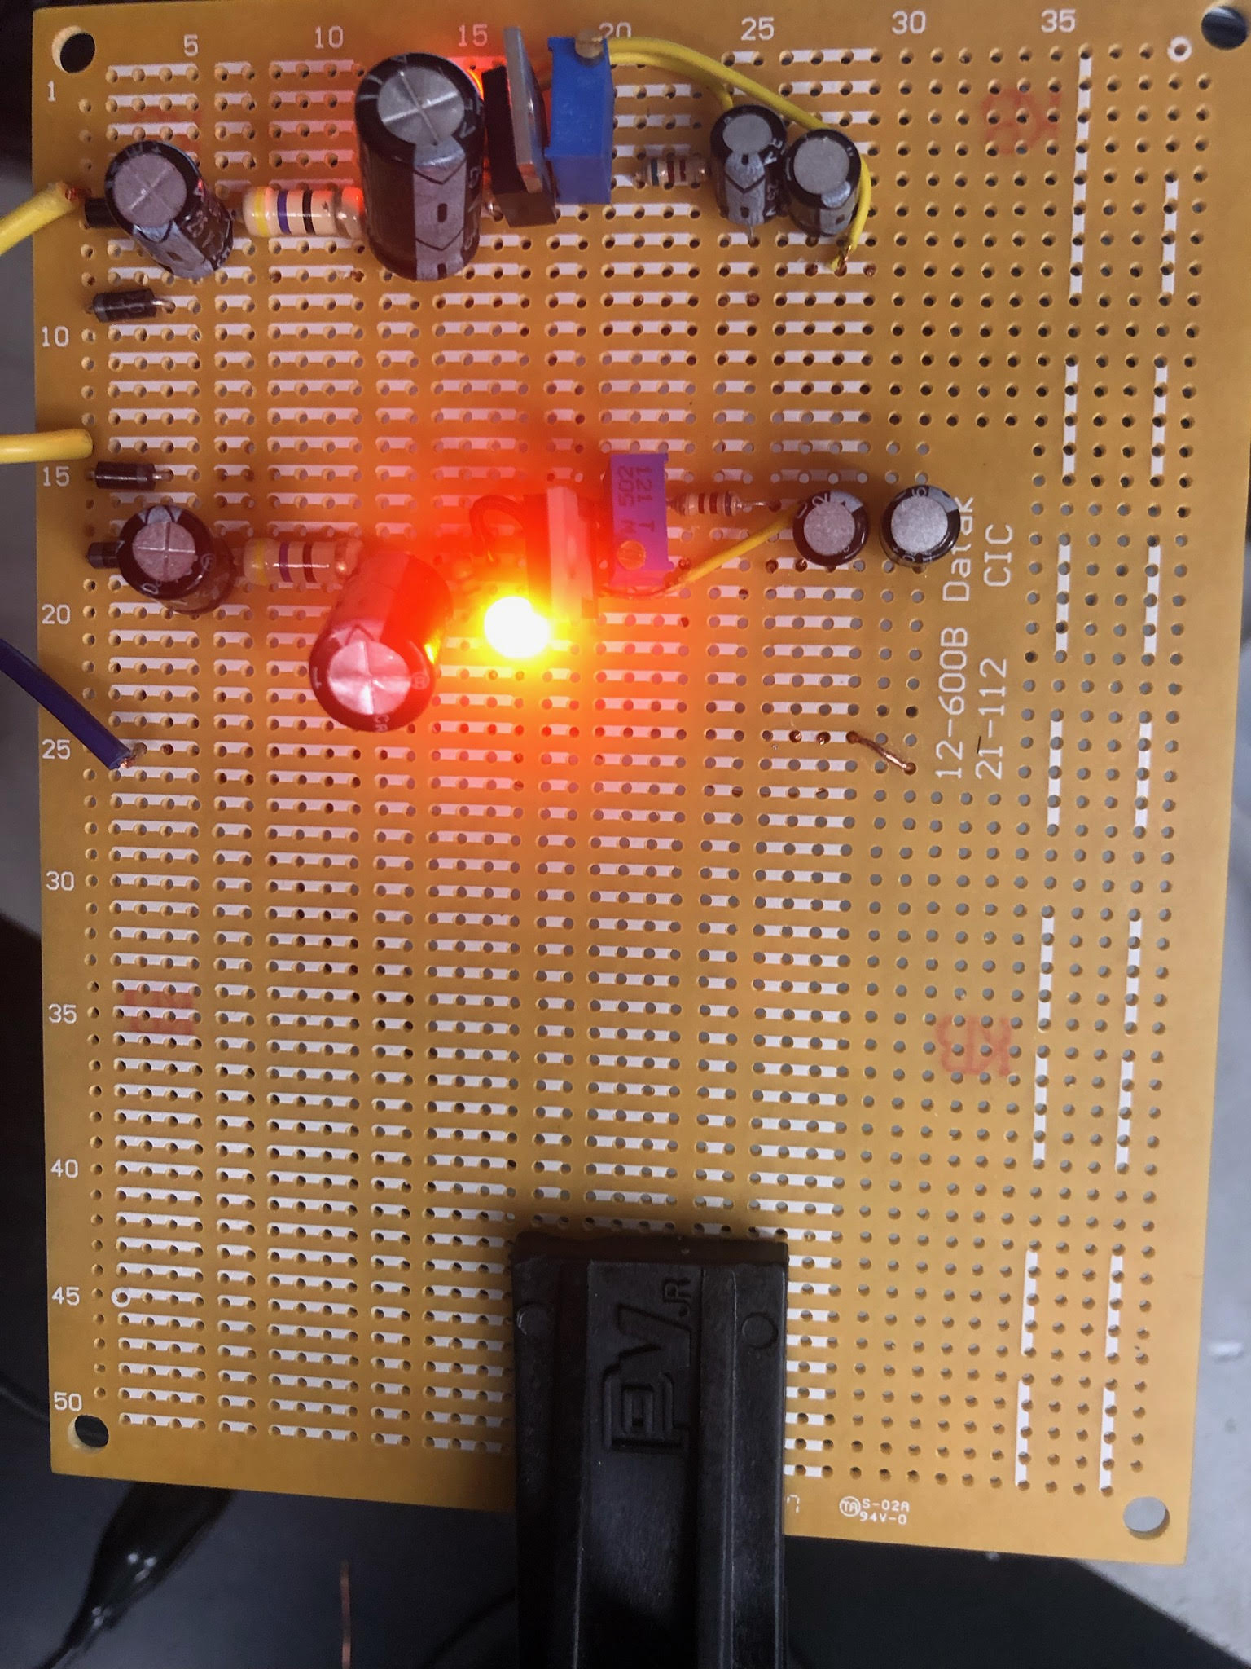
Lab 4: Part 5
This is our power supply that we built.
Our startup time for our power supply was 75 milliseconds

Slide 25
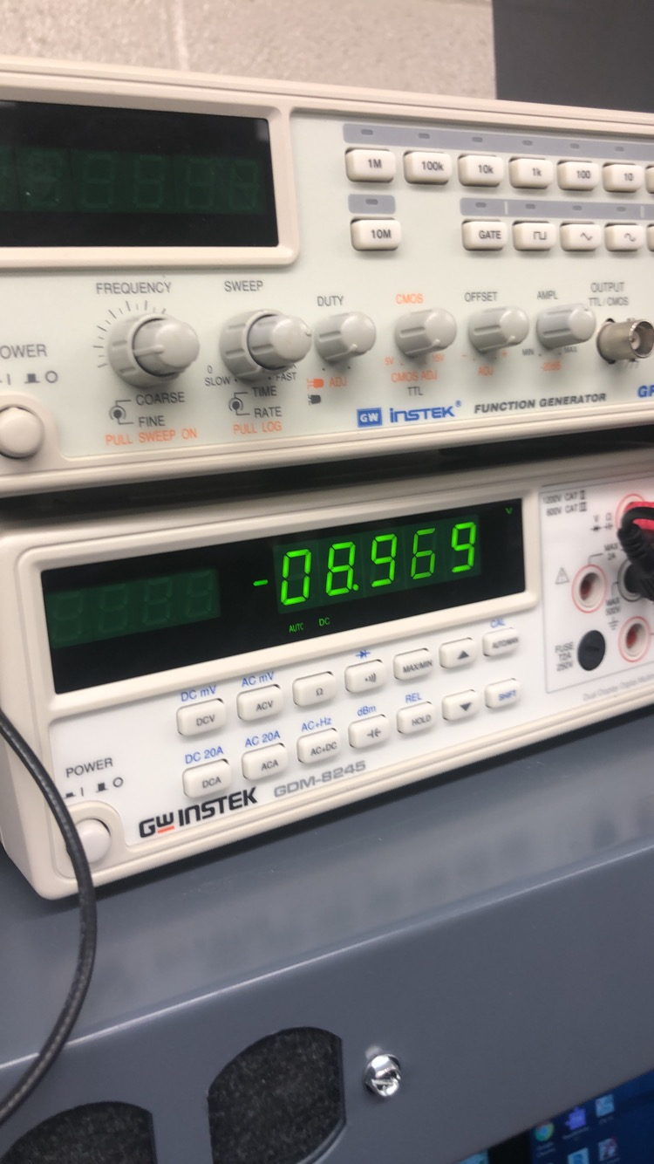
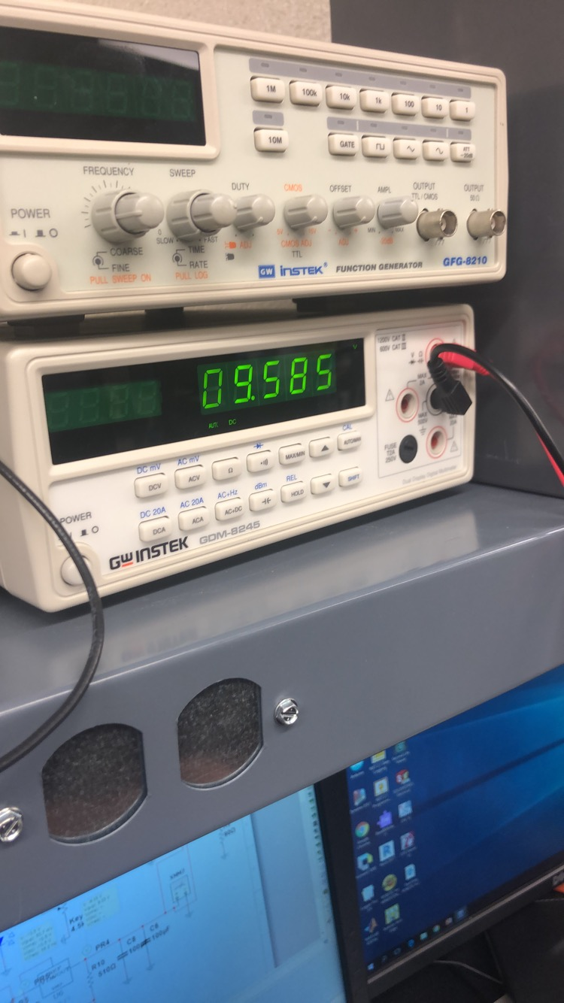
Lab 4: Part 6
This is the negative voltage coming from thee put of the power supply
This is the positive voltage coming from thee put of the power supply

Slide 26
Lab 4: Observations
11/28/2018 : After we finished connecting the components on to a circuit board, we verified the polarities of the capacitors, on the negative side of the power supply, the negative is supposed to be wired to power and on the positive side it has to connect to ground. Everything was wired correctly, except one of our LED was connected backwards, and so exchanged that out. We tested it again to see if it works, however we weren’t getting an output on the negative side. Initially we thought it may be a defective 337 part, but after swapping that out we realized that it wasn’t that part. After further diagnostic, we found the the potentiometer was switched around. The last capacitor was also not wired to anything, which was our last issue before we got it to work. Then we tried switching are first two capacitors around but the created the problem of not having 9 volts at the output.

Slide 27
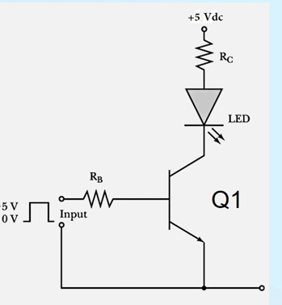
Lab 5: Common Emitter Amplifier
Lab Partner was Seth wills and Jarred Clark and Donald Stanley
The purpose of this lab is to:
See how a common a transistor is used for a common emitter amplifier
Equipment Need:
1 – GDM-8245 Multi-meter
1 – HY1802D DC Power source
1 – Breadboard
1- LED
1-2N2222A Transistor
1- 220 ohm resistor
1- 500 resistors

Slide 28
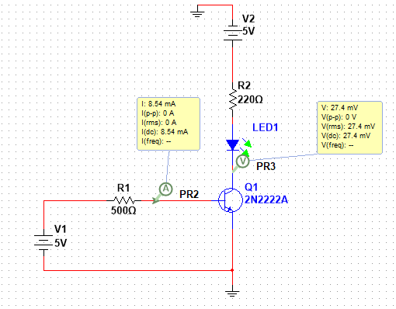
Lab 5: Common Emitter Amplifier
Insert Multisim for Lab 5

Slide 29
Lab 5 Part: 3
Vin= | 5
Q1= | 2N2222A
RB= | 220
RC= | 500
LED= | 08LX330 RED
LED Min Current= | 1 | A
LED VF= | 2.682 | V
VCE when LED is "on"= | 2.025 | V
VCE when LED is "off"= | 3.974 | V
This is the spreadsheet for the calculated results for Lab 5

Slide 30
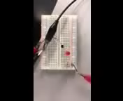
Lab 5: Part 3
This is a video of the transistor being used as a common emitter amplifier. We used a red led, 1 390 ohm resistor and 2 1k resistors in parallel

Slide 31
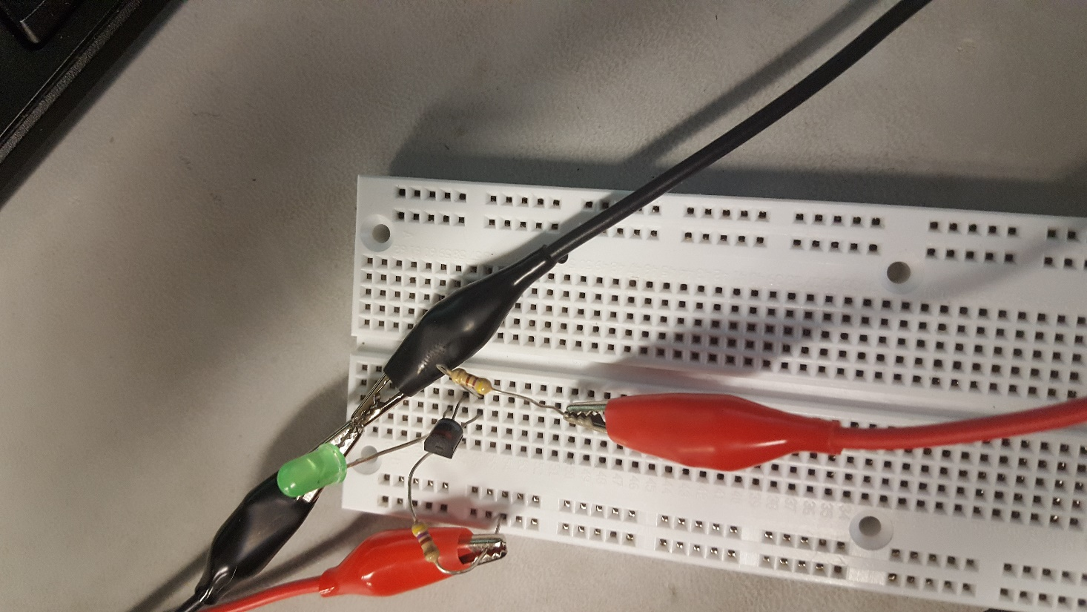
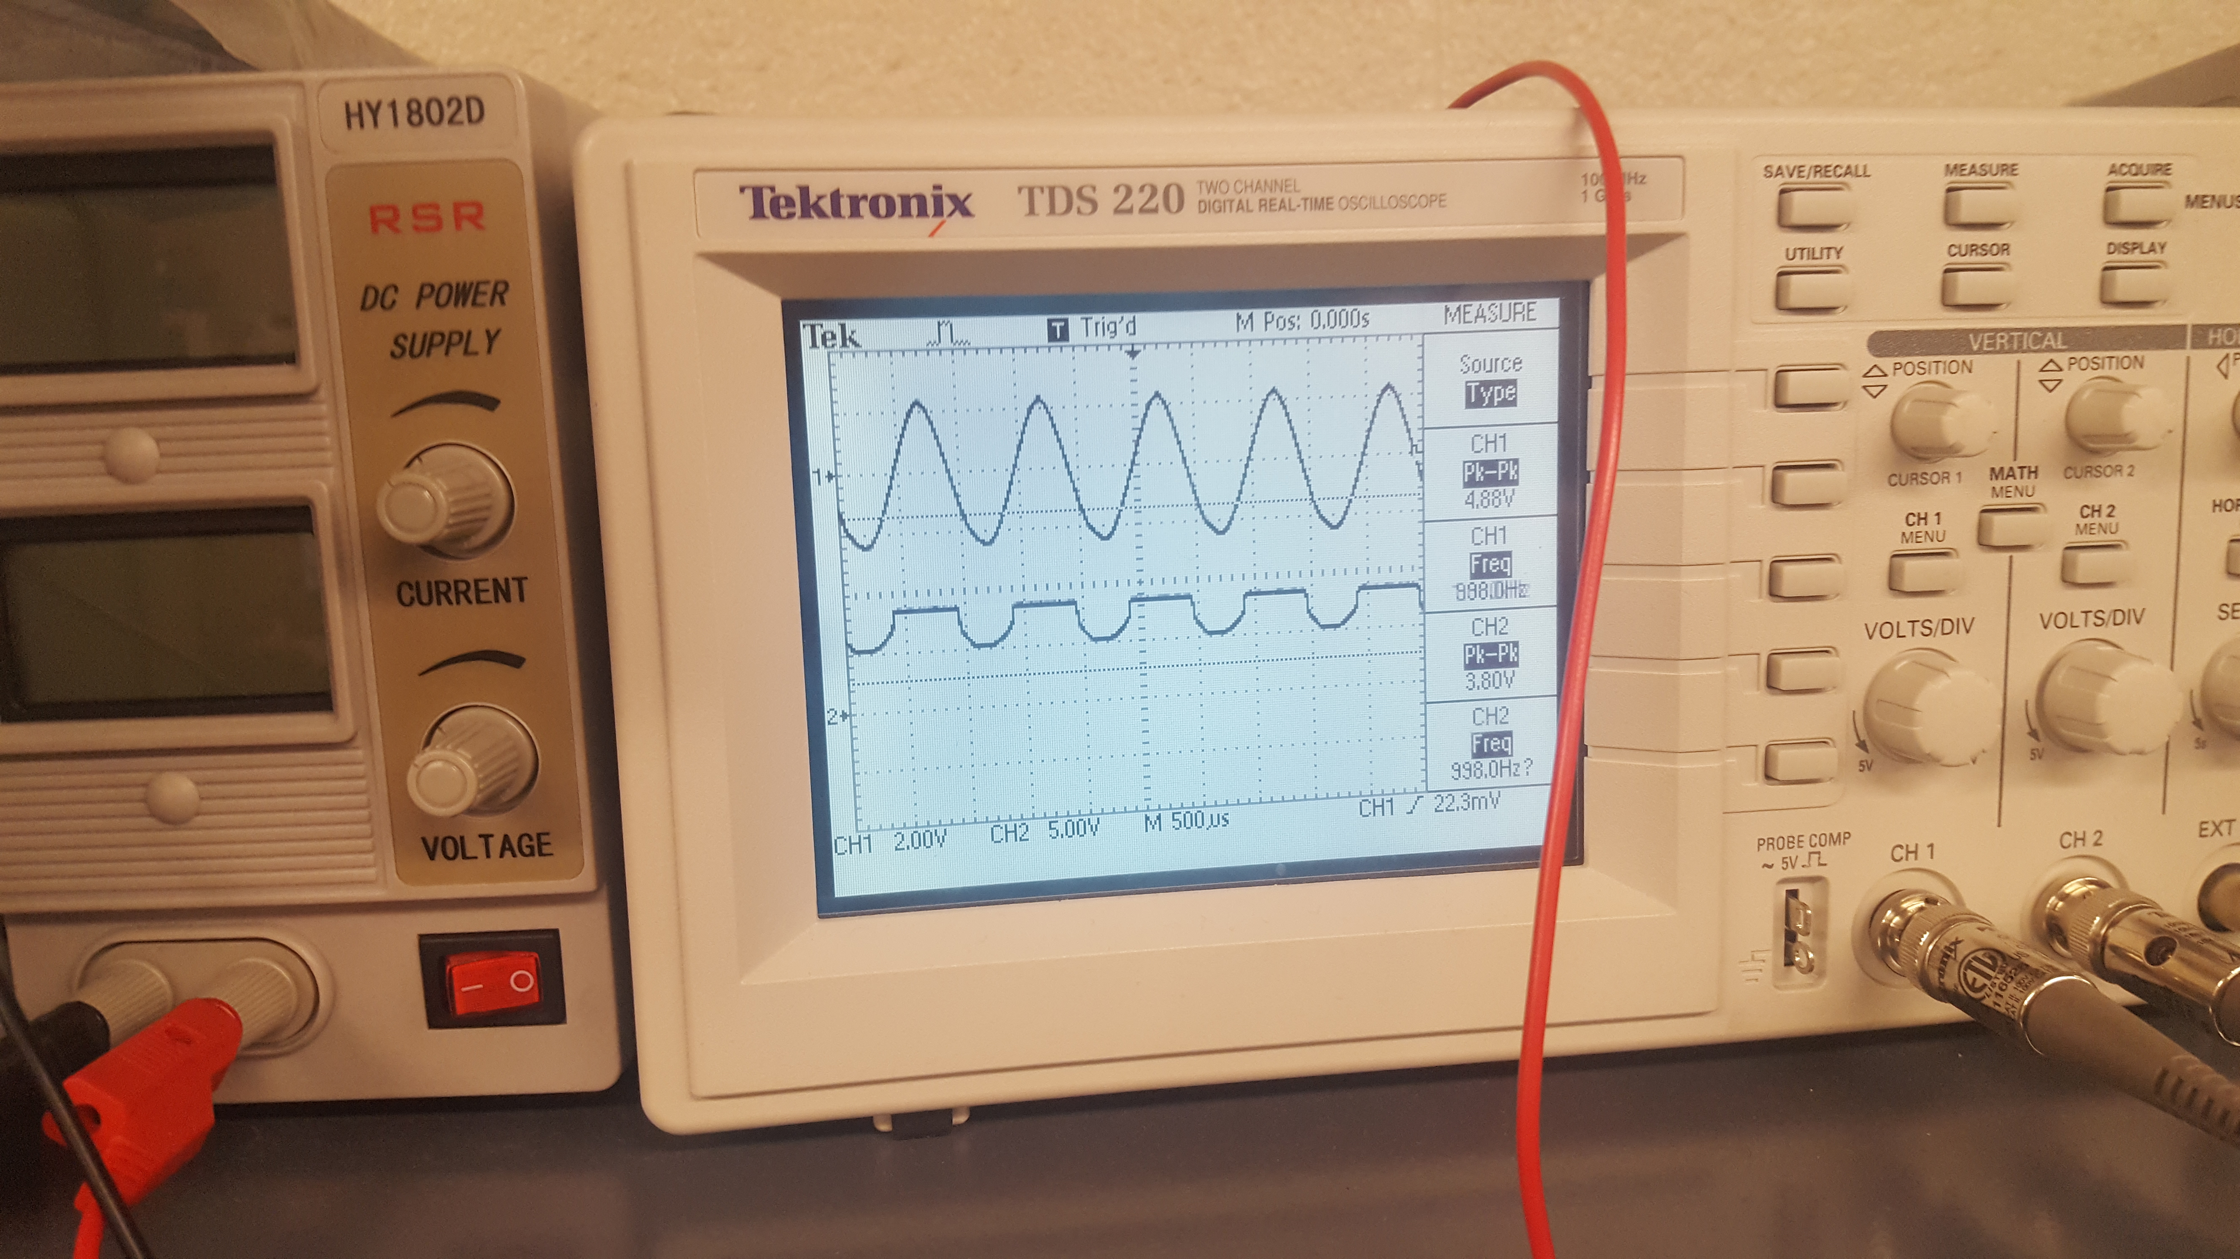
Lab 5: Part 4
This is the complete build of Lab 5’s Circuit
This is the Oscilloscope reading for Channel 1

Slide 32
Lab 5: Observations
We observed that one way to use the diode as a switch is by changing the collector voltage, in our case it was at 3V where it turned off.

Slide 33
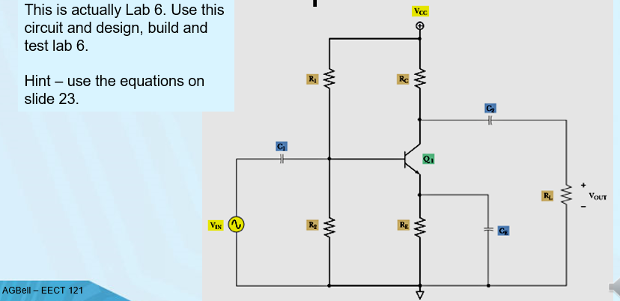
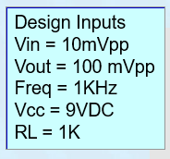
Lab 6: Common Emitter (CE) Amplifier
Lab Partner was Seth wills and Jarred Clark and Donald Stanley
Equipment Need:
1 – GDM-8245 Multi-meter
1 – HY1802D DC Power source
1 – Breadboard
1-2N2222A Transistor
5- 1k, 220k, 50, 22k, 50 ohm resistors
3-1uf, 47uf and 47uf capacitor

Slide 34
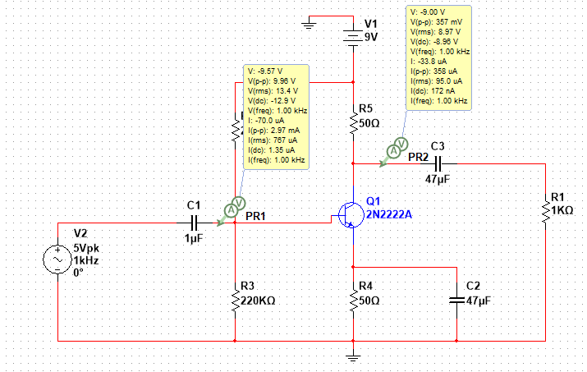
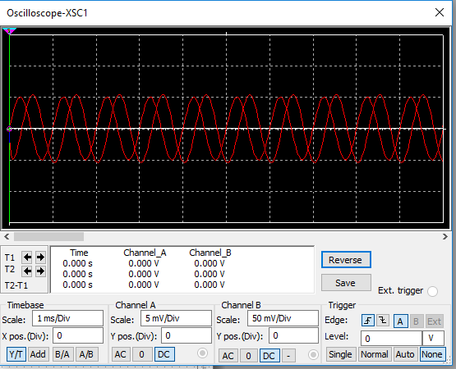
Lab 6: Part 2

Slide 35
Lab 6: Part 3
R1 | 2.20E+04
RC | 2.20E+05
R2 | 5.00E+01
RE | 5.00E+01
RL | 1.00E+03
VIN | 1.00E-03
VCC | 9
VOUT | 1.00E-01
C1 | 04.7E-06
C2 | 04.7E-06
CE | 01.0E-06
Q1 | 2N2222A
FREQ | 1.00E+03
IE
VC | 9
This is the Excel Sheet for the Calculation results for Lab 6

Slide 36
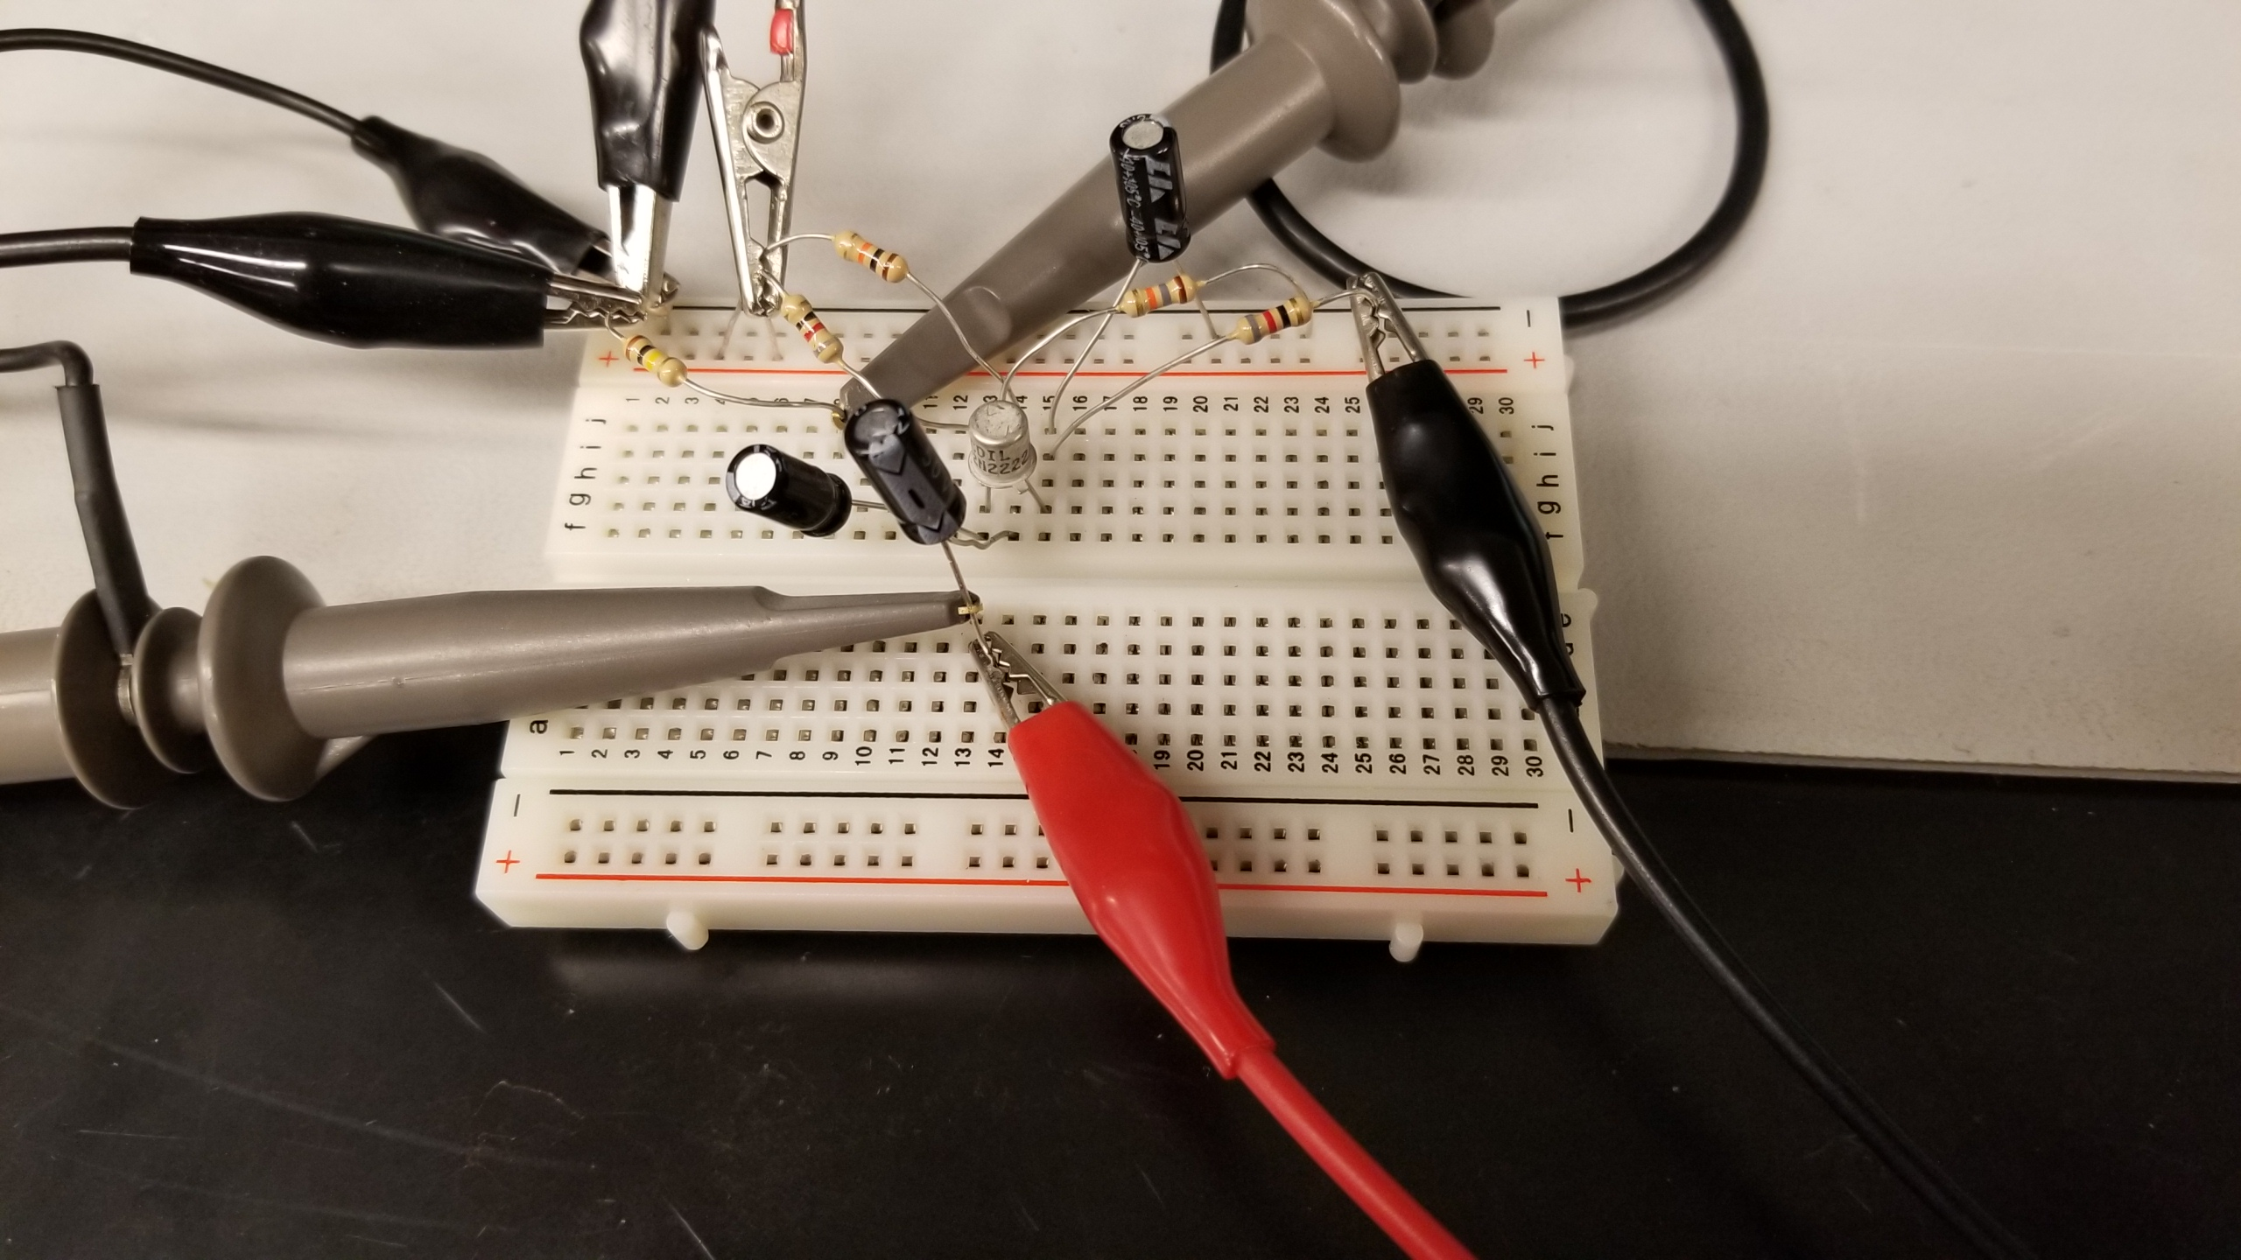
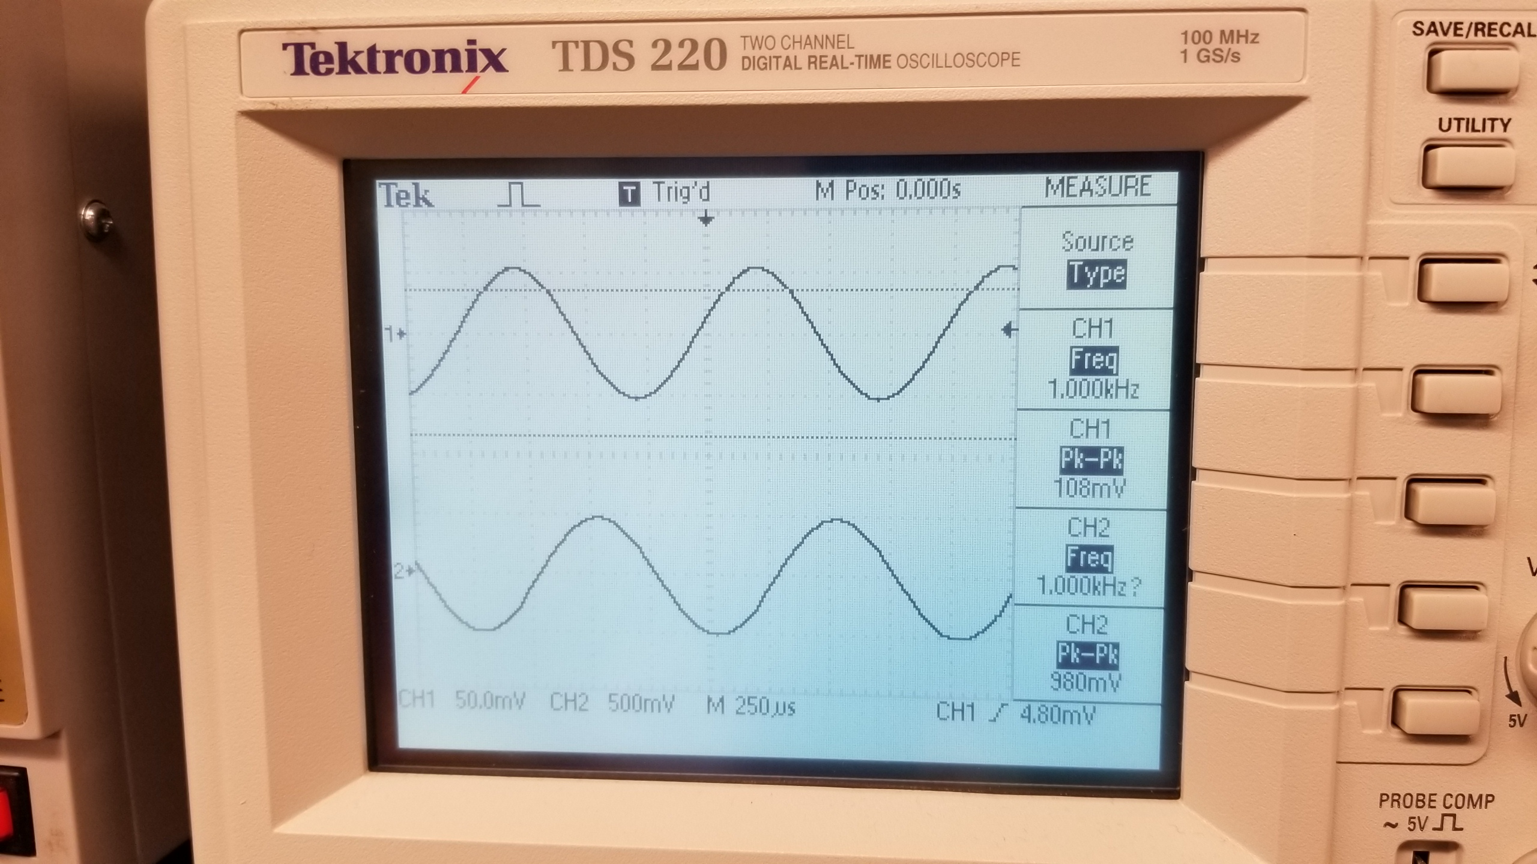
Lab 6: Part 4
This is the complete build for the circuit for lab 6
This is the Oscilloscope reading for channel1 for lab 6

Slide 37
Lab 6: Observations
We had a few issues calculating the resistor values and capacitor values, and it was a little difficult to build. We compared our results to the example lab notebook and we ended up getting a cleaner reading than they received on their oscilloscope

Slide 38
Lab 7: Using a JFET to flash an LED
My Lab Partner was Jarred Clark and Seth Wills and Donald Stanley
The Purpose of this is lab is to design, build/test a JFET circuit and using it to flash an LED.
Equipment Needed:
1-2N5457 JFET Amplifier
2- 470 Ohm Resistors
1- Yellow LED
1- Gwinstek Function Generator
1 – GDM-8245 Multi-meter
1 – HY1802D DC Power source

Slide 39
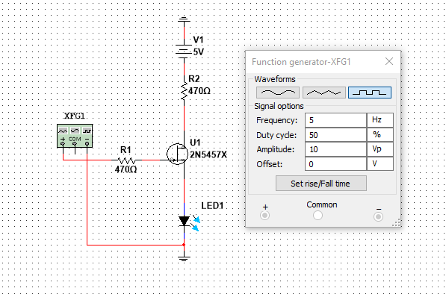
Lab 7: Part 2
We had to manually design the JFET in Multisim

Slide 40
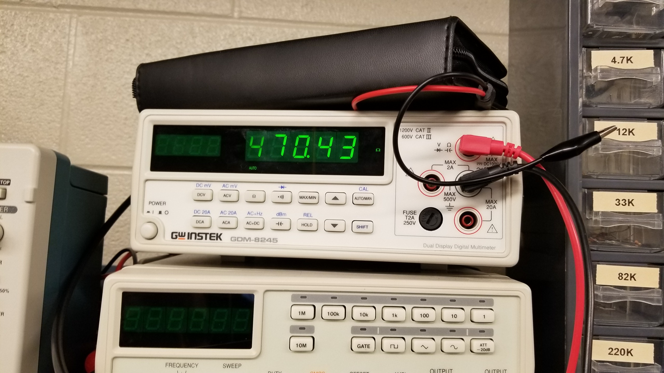
Lab 7: Part 3
The datasheet for the JFET
2N5457
This the multimeter for the 470 ohm resistor which is reading 470.43 Ohms

Slide 41
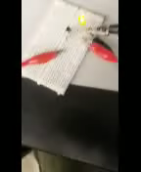
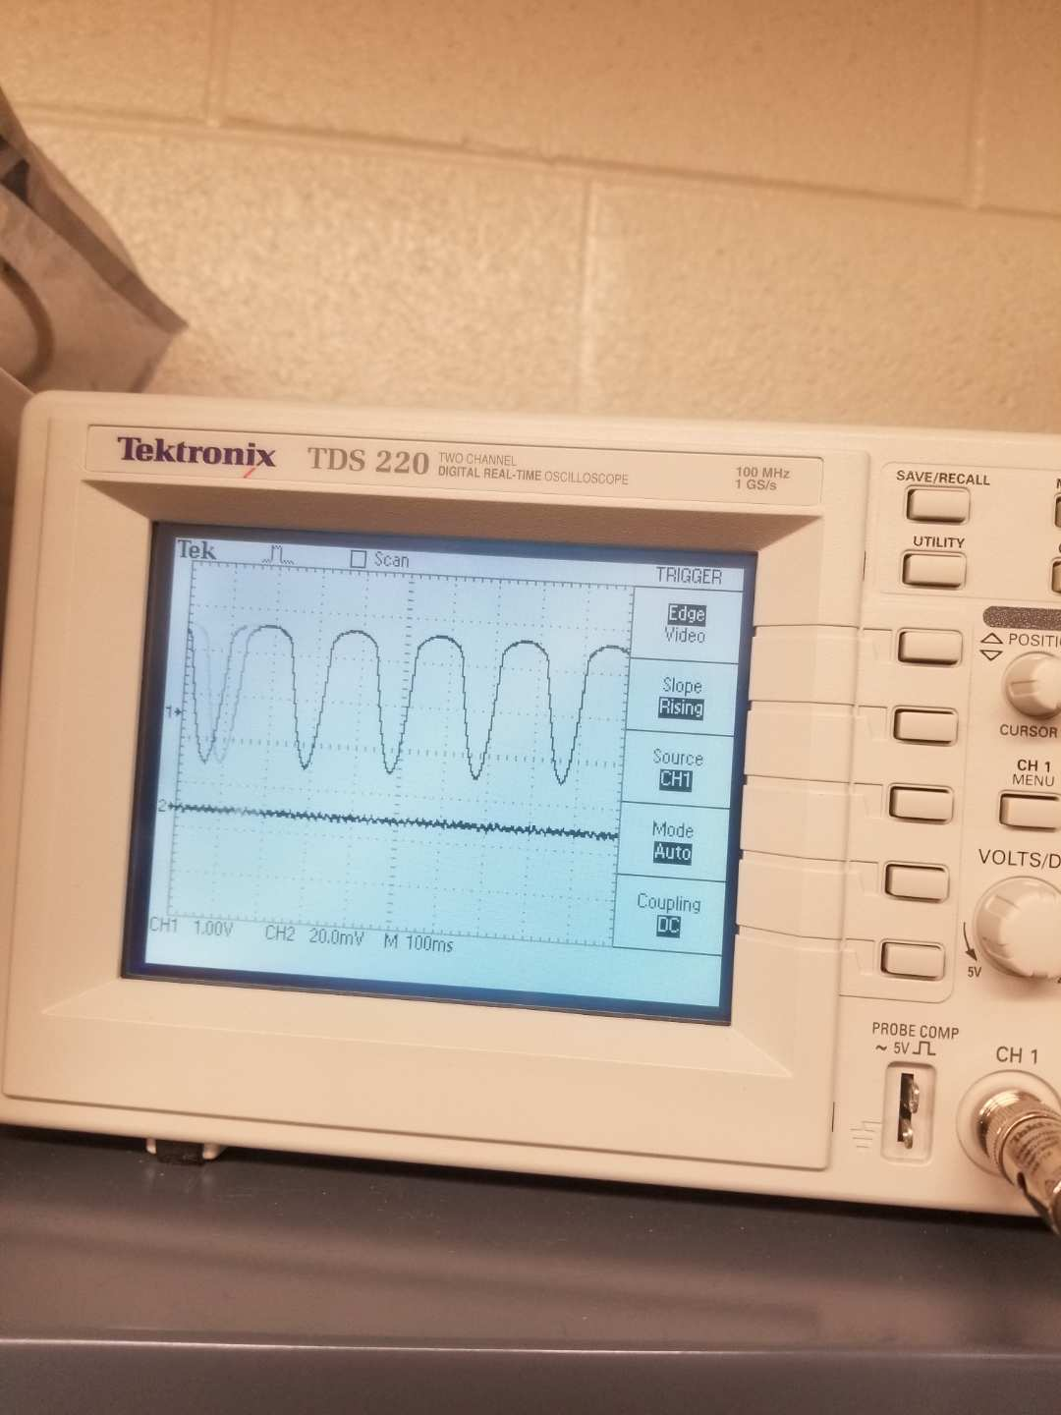
Lab 7: Part 4
Preview attachment 20181205_175347_001.mp4
20181205_175347_001.mp4
365 KB
This is the video showing the function generator and the Led flashing on and off
This is the Oscilloscope reading for the led turning on and off

Slide 42
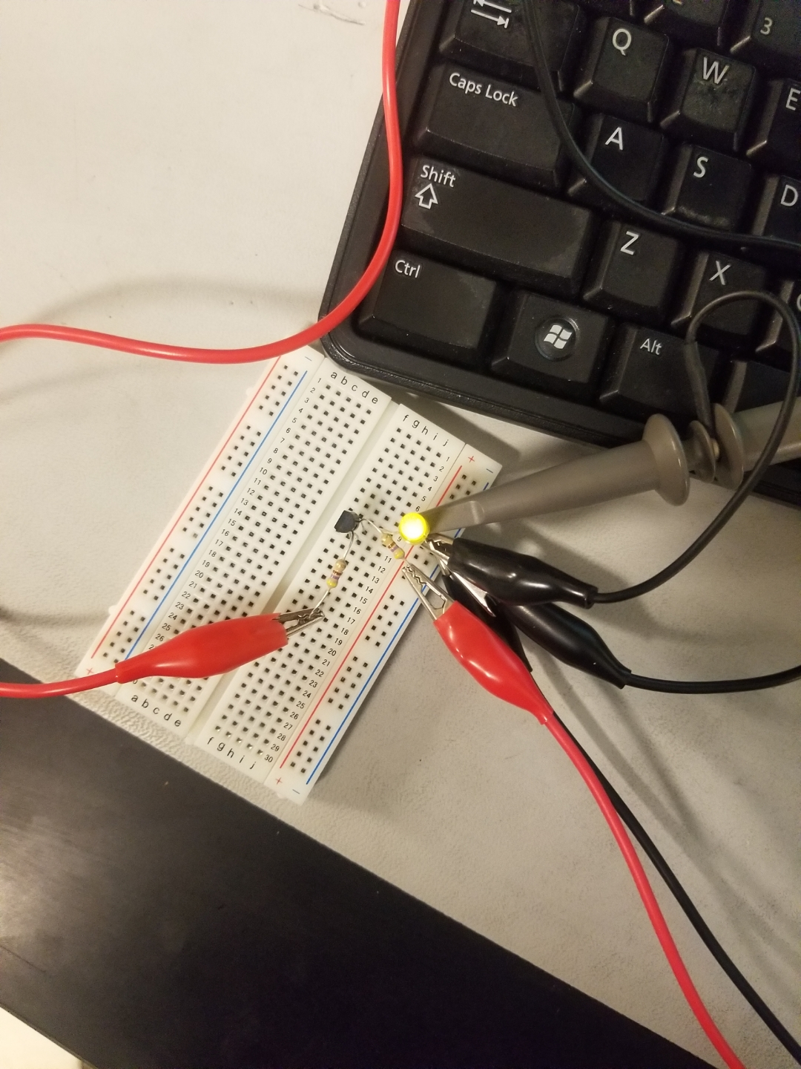
Lab 7: Part 5
This is the picture of the complete build for Lab 7

Slide 43
Lab 7: Observations
The circuit was not too difficult to build. The only complication that we ran into is that we put the JFET in backwards. We changed the frequency to make it flash slower and faster.

Slide 44
Lab 8: Using the JFET as a Amplifier
My Lab Partner was Kyaw Ya and Donald Stanley
The Purpose of this lab is to test and build an Amplifier circuit using a JFET
Equipment Needed:
1-2N5457 JFET Amplifier
1- Gwinstek Function Generator
1 – GDM-8245 Multi-meter
1 – Tenna Lab DC Power Supply
2- 1uf Capacitors
1-22k ohm resistor
1- 33k ohm resistor
1-100k resistor as a load
1- 4.7k ohm resistor

Slide 45
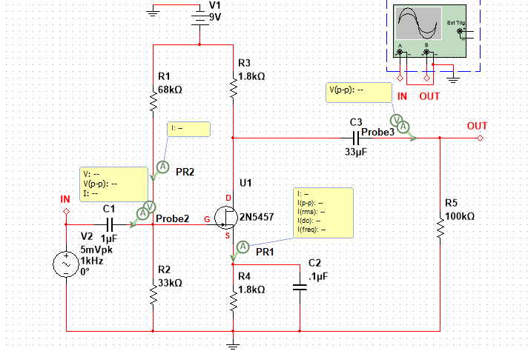
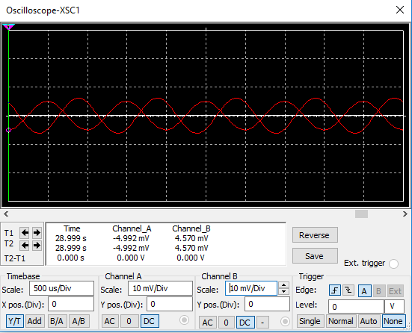
Lab 8: part 2
Our capacitor values are wrong that’s why we have a little bit of distortion we tried to figure it out but failed to

Slide 46
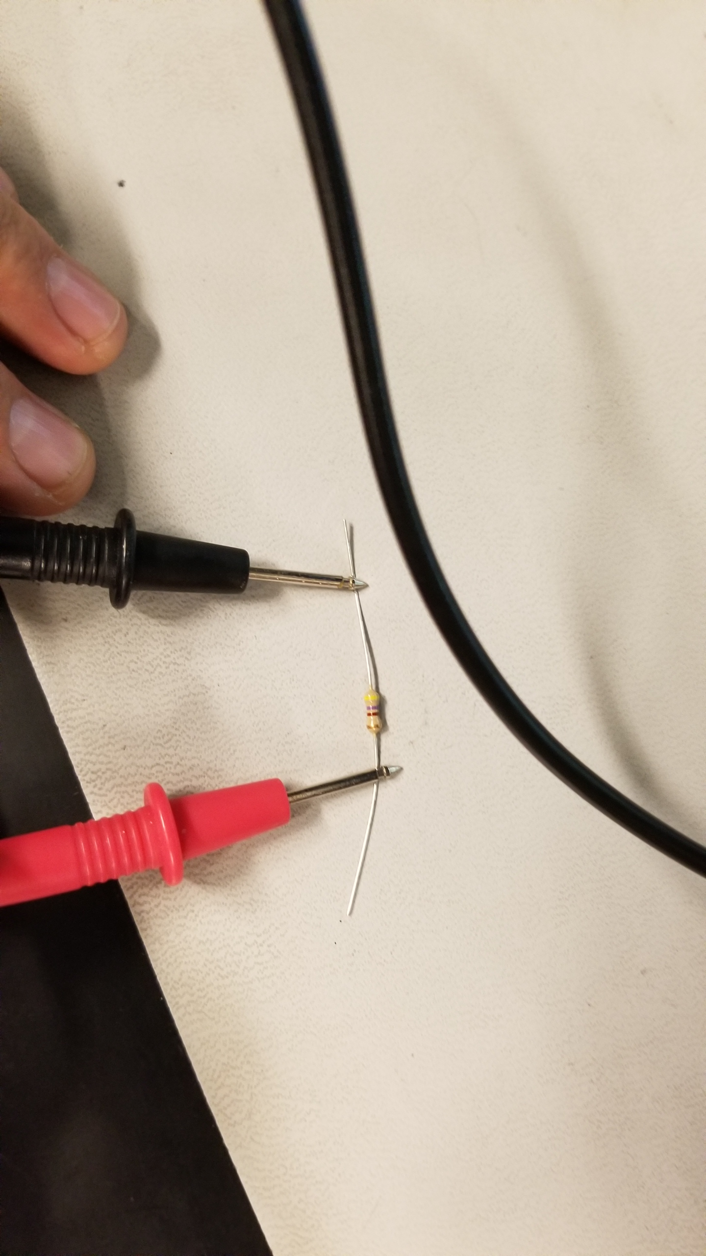

Lab 8: Part 3
Measuring the 22k ohm resistor with the multimeter

Slide 47
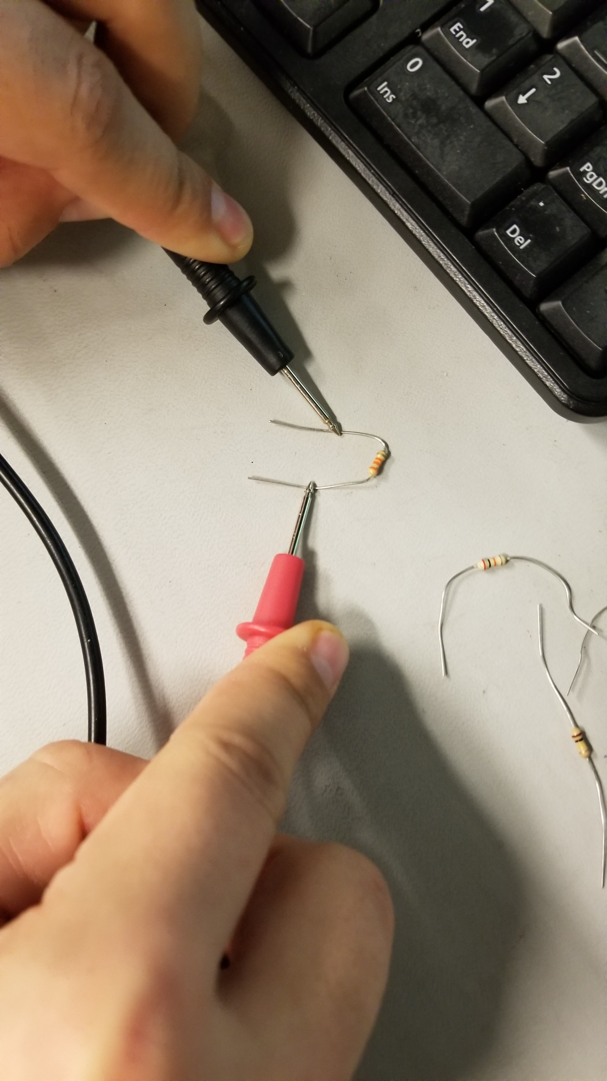
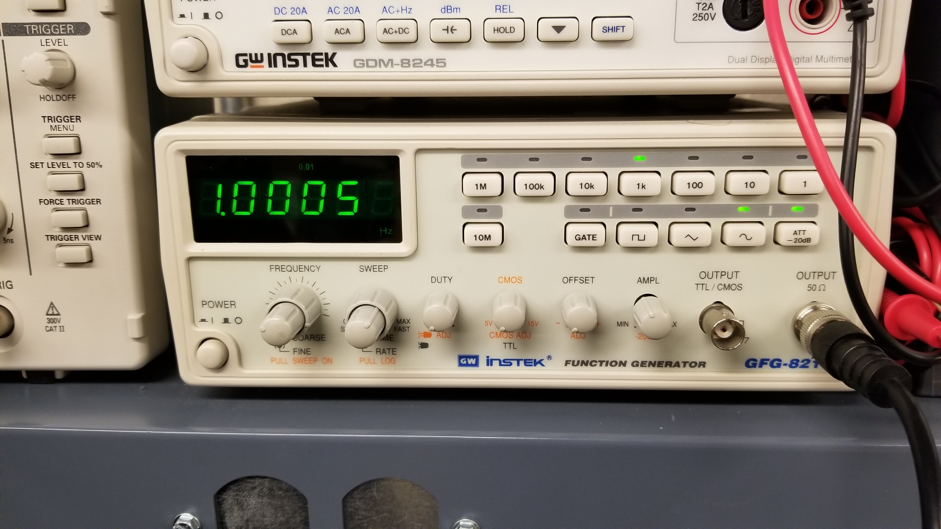
Lab 8: Part 4
Measuring the 33k Ohm resistor using the multimeter
This is the frequency that was the input for the circuit which is a 1kHz

Slide 48


Lab 8: Part 6
This is the correct circuit that is build that gave us the correct results
This is the correct reading for the oscilloscope which the two sine waves are almost 180 out of phase of eachother

Slide 49
Lab 8: Observations
We got the wave form to be 180 degree phase diffent but we had some distortion due to some of our resistor and capasitor values being wrong. We tried to fix it but we failed to.

Slide 50
Lab 9: High pass filter
My Lab Partner was Jarred Clark, kyaw ya, Donald Stanley and Seth Wills
The Purpose of this Lab was to build and calculated a high pass filter using multisim and excel, Which is used to filter frequencies above a set range

Slide 51


Lab 9: Part 2
This is the multisim simulation for Lab 9

Slide 52
Lab 9: pArt 3
HIGH PASS FILTER
A0= | 1
a1= | 1.4142
b1= | 1
C= | 100.0E-9
C1= | 100.0E-9
C2= | 100.0E-9
R1= | 2.3E+3
R2= | 1.1E+3
fc= | 1.0E+3 | Hz
This is the excel spreadsheet for Lab 9

Slide 53
Lab 10: Low pass filter
My Lab Partners were Jarred Clark, kyaw ya, Donald Stanley and Seth wills
The Purpose of this Lab was to build and calculated a high pass filter using multisim and excel, Which is used to filter frequencies with a mid range

Slide 54


Lab 10: Part 2
This is the multisim simulation for Lab 10

Slide 55
Lab 10: Part 3
LOW PASS FILTER
A0= | 1
a1= | 1.4142
b1= | 1
C1= | 22.00E-9 | 4.7E-08
C2= | 44.00E-9
R1= | 3.82E+3
R2= | 6.41E+3
fc= | 1000 | Hz
This is the excel spreadsheet for Lab 10

Slide 56
Lab 11: Band-Pass Filter
My lab partners were Jarred Clark, kyaw ya, Donald Stanley and seth wills
The Purpose of this Lab was to build and calculated a high pass filter using multisim and excel, Which is used to filter frequencies with a mid range and is considered a Mid-pass filter

Slide 57


Lab 11: Part 2
This is the multisim simulation for Lab 11

Slide 58
Lab 11: Part 3
R1 | 7.96E+03
R2 | 31.83E+3
R3 | 80.38
C | 100.0E-9
C1 | 100.0E-9
C2 | 100.0E-9
AM | -2.0
Q | 10.0
fm | 1000 | Hz
B | 157.08 | bandwidth
Q | 10.00E+0 | filter quality
Am | 2.00E+0 | gain at fm
This is the excel spreadsheet for Lab 11

Slide 59
Lab 12: Notch Filter
My lab partners were Jarred Clark, kyaw ya, seth wills and Donald stanley
The Purpose of this Lab was to build and calculated a high pass filter using multisim and excel, The Notch filter is used to isolate specific frequencies in a circuit and filter them out.

Slide 60


Lab 12: Part 2
This is the multisim simulation for Lab 12

Slide 61
Lab 12: Part 3
fm= | 1000 |  | Mid Freq
G= | 5.7 |  | Inner Gain
A0= | 6 |  | Passband Gain
Q= | -135.14E-3 |  | Rejection Gain
C= | 100.00E-9
C1= | 100.00E-9
C2= | 100.00E-9
C3= | 200.00E-9
R= | 1.59E+3
R1= | 1000
R2= | 4700
R3= | 1.59E+3
R4= | 1.59E+3
R5= | 795.77E+0
This is the excel spreadsheet for Lab 12

